Slide 1
Overview of
ICC Standards and Guidelines
Where we are at today and where we are going.
Karl W. Aittaniemi, P.E.

Slide 2

Karl Aittaniemi, P.E.
Karl supervises the standards development staff in their roles supporting the development and support of ICC’s Codes and Standards since joining ICC in April 2018.
Karl holds a bachelor degree in Mechanical Engineering from Southern Illinois University – Carbondale in addition to an MBA from Worcester Polytechnic Institute, Worcester Massachusetts. He has a Certificate of Graduate Study in Fire Protection Engineering from Worcester Polytechnic Institute, Worcester, Massachusetts. He is a licensed professional engineer in several states.

Slide 3
Purpose of a Standard
A standard is an agreed way of doing something.
Standards are designed to ensure products, services and systems are safe, reliable and consistently perform the way they are intended to.
They establish common values that define safety and quality requirements.
Standards become mandatory when they have been incorporated into a business contract or incorporated into regulations.

Slide 4
When a standard is referenced
The standard reference number is indicated in the code section
The standards are listed in the last chapter of the code
  Subdivided by promulgator
  Edition/year reference indicated.
  Approximately 1500 standards in the I-Codes and over 535 in the IBC.

Slide 5
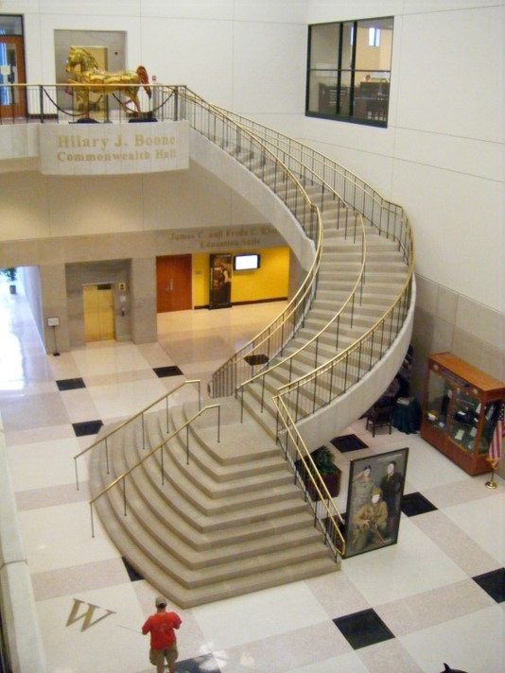
Limitation of a referenced standard
IBC Section 102.4
Considered part of the code to the extent referenced
Examples in A117.1 that are not referenced – stairways, Type C units
Conflicts – codes rule

Slide 6
Purpose of a Guideline
A guideline is a statement by which to determine a course of action.
A guideline aims to streamline particular processes according to a set routine or sound practice.
Following a guideline is never mandatory. Guidelines are not binding and are not enforced.

Slide 7
How ICC Standards are developed:
A need is identified by industry or ICC’s membership to develop a standard.
A standards project is approved and a committee is appointed through the application process by the ICC Board of Directors.
ICC’s ANSI Approved Consensus Procedures are followed to develop the standard in the most time efficient way.

Slide 8
ICC Standards webpages for current committee news and documents:
https://www.iccsafe.org/products-and-services/standards-development/standard-development-process/
ANSI Accreditation
The Code Council is accredited by the American National Standards Institute (ANSI) as a standards developing organization that adheres to ANSI’s Essential Requirements for openness, balance, consensus and due process. Participation of the various stakeholders in an equitable, accessible and responsive environment is key in developing a consensus standard for recognition as an American National Standard.

Slide 9
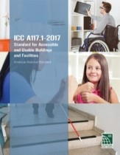
ICC A117.1 –Accessible and Usable Buildings and Facilities -2017
To provide technical criteria that will allow a person with physical disability to independently get to, enter, and use a site, facility, building or element.
Disabilities addressed include the inability or difficulty walking, blindness and visual impairment, deafness and hearing impairment, incoordination, reaching and manipulation disabilities, lack of stamina, difficulty in interpreting and reacting to sensory information, and extremes in physical size.
Currently in the revision cycle. First round of public comments have been received on April 5, 2021 are up for consideration by the committee.

Slide 10
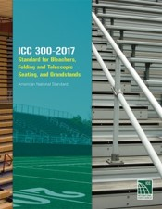
ICC 300 Bleachers, Folding and Telescopic Seating and Grandstands- 2017
To provide technical criteria associated with bleacher seating.
It addresses new and existing installations of all types of bleacher seating including fixed and folding bleachers intended for indoor, outdoor, temporary and permanent use.
This Standard is intended to coordinate with the means of egress systems in the building codes.
Revision cycle has opened. Applications for the committee have been received for consideration by the ICC BODs.

Slide 11
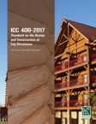
ICC 400 Design and Construction of Log Structures-2017
Provide the minimum design requirements for new log structures or portions of buildings using logs.
Types of logs – unsawn, sawn, milled and glue-lam.
Including material qualifications, structural, thermal envelope and fire resistance provisions.
Currently in the revision cycle. 2017 edition with committee revisions will be posted for ANSI public review period in late April 2021.

Slide 12
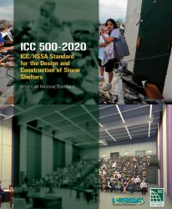
ICC 500 Design and Construction of Storm Shelters - 2020
Published jointly ICC & the National Storm Shelter Association (NSSA)
  Provides minimum design and construction requirements for storm shelters for safe refuge from storms that produce high winds, hurricanes, and tornadoes.
  Provides design requirements for the main wind resisting structural system and components and cladding of these shelters.
  Provides basic occupant life safety and health requirements including means of egress, lighting, sanitation, ventilation, fire safety, and minimum required floor space for occupants.
  Just completed the current 2020 edition in Nov 2020. Committee is on continuous maintenance.

Slide 13
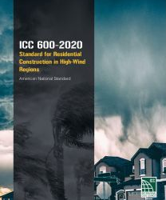
ICC 600 Residential Construction in High-Wind Regions – 2020
Prescriptive methods to provide wind resistant designs and construction details for residential buildings sited in high- wind regions where design wind speeds are 120 to 180 mph.
Improve building resiliency by improving structural integrity and envelope performance.
Just completed current 2020 edition in Nov 2020.
Suite of hazard mitigation standards to be developed:
ICC 605 - Standard for Residential Construction in Regions with Wildfire Hazard
ICC 610 - Standard for Residential Construction in Regions with Seismic Hazard
ICC 615 - Standard for Residential Construction in Regions with Tsunami Hazard

Slide 14
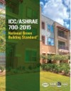
ICC 700 National Green Building Standard -2015
Published jointly by ICC and American Society of Heating, Refrigerating and Air-Conditioning Engineers (ASHRAE)
Outlines a variety of green practices that can be incorporated into single-family homes and multifamily buildings, as well as hotels, dormitories and land developments.
New construction, renovations and additions.
Including site and lot design, preparation and development; resource, energy and water efficiency; indoor environmental quality; and operation, maintenance and building owner education.
Four levels—Bronze, Silver, Gold and Emerald

Slide 15
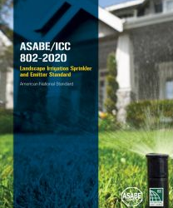
ICC 802 Landscape Irrigation Sprinkler and Emitter Standard -2020
Published jointly with American Society of Agricultural and Biological Engineers (ASABE)
Intent:
To address the design, features, performance and testing of sprinklers, bubblers and emitters used in landscape irrigation systems.
Just completed current 2020 edition in Nov 2020.

Slide 16
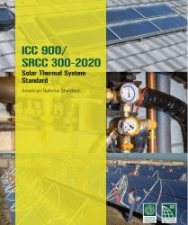
ICC 900 Solar Thermal System Standard -2020
Published jointly with Solar Rating & Certification Corp. (SRCC)
Establishes minimum requirements for the system design, performance evaluation and installation instructions of solar water heating systems. A methodology for rating the performance of solar water heating systems based on performance projections and solar collector test data for residential and commercial solar water heating systems intended for use within swimming pool heating, building space heating, building space cooling and/or water heating systems.
Just completed current 2020 edition in Nov 2020.
Suite of solar-thermal standards:
ICC 901, 902 and new 903

Slide 17
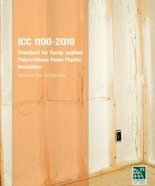
ICC 1100 Standard for Spray-applied Polyurethane Foam Plastic Insulation-2019
Basic installation requirements and establishes minimum physical property and performance requirements for spray-applied polyurethane foam plastic thermal insulation to demonstrate compliance with the intent of model building codes.

Slide 18
New ICC 1200 & 1205 Standards for Off-Site Construction
Under development.
Addresses challenges for the inspection and regulatory compliance of off-site construction.
ICC 1200 applies to planning, design, fabrication and assembly of off-site construction.
ICC 1205 applies to Inspection and Regulatory Compliance.
ICC 1210 project initiated for Mechanical, Electrical, Plumbing Systems, Energy Efficiency and Water Conservation in Off-site Construction

Slide 19
New ICC 1300 Standard for the Vulnerability-Based Seismic Assessment and Retrofit of One- and Two-Family Dwellings
Under development.
Provides a methodology for the identification, evaluation and retrofit of specific known vulnerabilities for one- and two-family wood light-frame residential buildings (including townhouses) up to 2 stories in height. Also included is the evaluation and retrofit of masonry chimneys attached to 3 story buildings. Development of the assessment and retrofit provisions are applicable to dwellings located in Seismic Design Categories B through E and will include the use of the best available seismic numerical modeling tools and engineering practices to assist in development of assessment methods and to identify retrofit criteria to best achieve targeted performance objectives. Use of the provisions are anticipated to improve earthquake performance but is not intended to prevent earthquake damage.

Slide 20

ICC G1 Guidelines for Replicable Buildings – 2010
Streamlining a building document review process to examine and verify replicable construction documents; thus, eliminating repetitive code compliance reviews.
A global review of replicable documents paired with a local review of unique jurisdictional requirements
More cost effective
Conserve local resources through the elimination of repetitive reviews of transportable plans
Reduce the time between permit submittal and construction mobilization

Slide 21

ICC G2 Guidelines for Acoustics – 2010
Improved acoustical analysis of assemblies, components and installation methods, and a more detailed inspection process .
Two grades of acoustical performance: acceptable and preferred performance levels for air-borne and structure-borne noise.
Specific design and evaluation techniques for managing this potential degradation of acoustical systems.

Slide 22
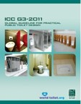
ICC G3 Practical Public Toilet Design -2011
Provide provisions to control the design, construction, and installation, quality of materials, location, operation and maintenance, and use of public toilets.
Basic care and maintenance of such facilities.

Slide 23
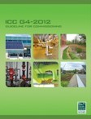
ICC G4 Guidelines for Commissioning – 2012
Commissioning is the process of assuring that all systems and components of a building system are designed, installed, tested, operated, and maintained according to the operational requirements .
Intent:
Enforce commissioning, either with in-house staff or the use of a third party.
Can used with codes and standards that require commissioning; including the International Green Construction Code® (IgCC®)

Slide 24
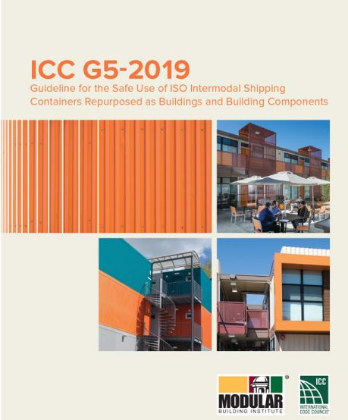
ICC G5 Guideline for The Safe Use of ISO Intermodel Shipping Containers Repurposed as Buildings and Building Components – 2019
Helps state and local jurisdictions, owners, architects, builders and engineers in their assessment as to how to design, review and approve shipping containers as a building element.
Co-developed with the Modular Building Institute (MBI).
Over 30 million containers in use today.

Slide 25
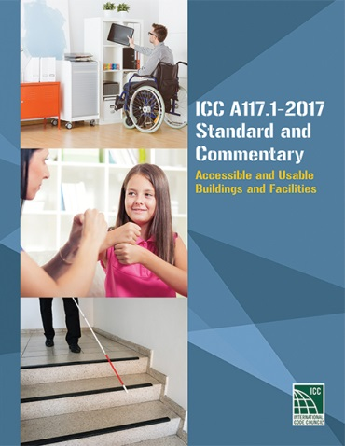
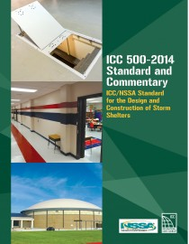
Commentaries
ICC offers commentaries for:
  ICC A117.1
  ICC 500
Each commentary includes every section of the standard followed by information on development reasons, history and supporting research for the requirements.
  ICC Standards and commentaries can be purchased at the ICC store at http://shop.iccsafe.org/standards/icc-standards.html

