Slide 1

Running a Chapter Like a Business

Slide 2
Alan R. Ellis
Alan Ellis is the Director of EduCode International, an annual training conference (both live and virtual) held in Las Vegas, Nevada for the past 28 years. He recently retired from the City of Henderson, NV as the Manager of Inspection Services, managing building, fire and business license inspectors. In prior years he also served as the Deputy Fire Marshal, Senior Inspector and fire inspector for the city.
Alan has been teaching numerous fire and building related courses as an Adjunct Instructor at the College of Southern Nevada for the past 25 years. He also has taught numerous classes for the State of Michigan and Nevada as he is a certified instructor in both states.
He holds numerous certifications through ICC, State of Michigan and Nevada, and other organizations and has a bachelor’s degree in social science and a master’s degree in business.
Alan was awarded the “Educator of the Year” by the International Code Council in 2022.
Aellis.educode@gmail.com

Slide 3

Mission vs. Vision
Vision = What is the Chapters hopes to Achieve Long Term- ‘Chapters Dream’ and “The What”
Mission = Always supports the Vision and How will the Chapter Achieve its Vision? “The How”
SNICC: The ‘mission’ of the Southern Nevada Chapter is to support its stakeholders in the creation and maintenance of a safe built environment.
Mission or Vision?
Creating safe,affordable,and sustainable buildings & Communities
To provide the information,tools and resources that
Members rely on, building safety professionals turn to
And the public trusts.
Both are necessary to effectively run your chapter

Slide 4

The Chapters Officers are Stewarts of the Chapter and Must be Good Leaders
One of Their Major Responsibilities are to Keep the Financial Aspects of the Chapter Intact
It helps if the board has some knowledge of running or managing A business or organization or Jurisdiction
Must be aware of:
local, state and *national economic factors, *issues and *forecasts
This Photo by Unknown Author is licensed under CC BY-SA-NC

Slide 5
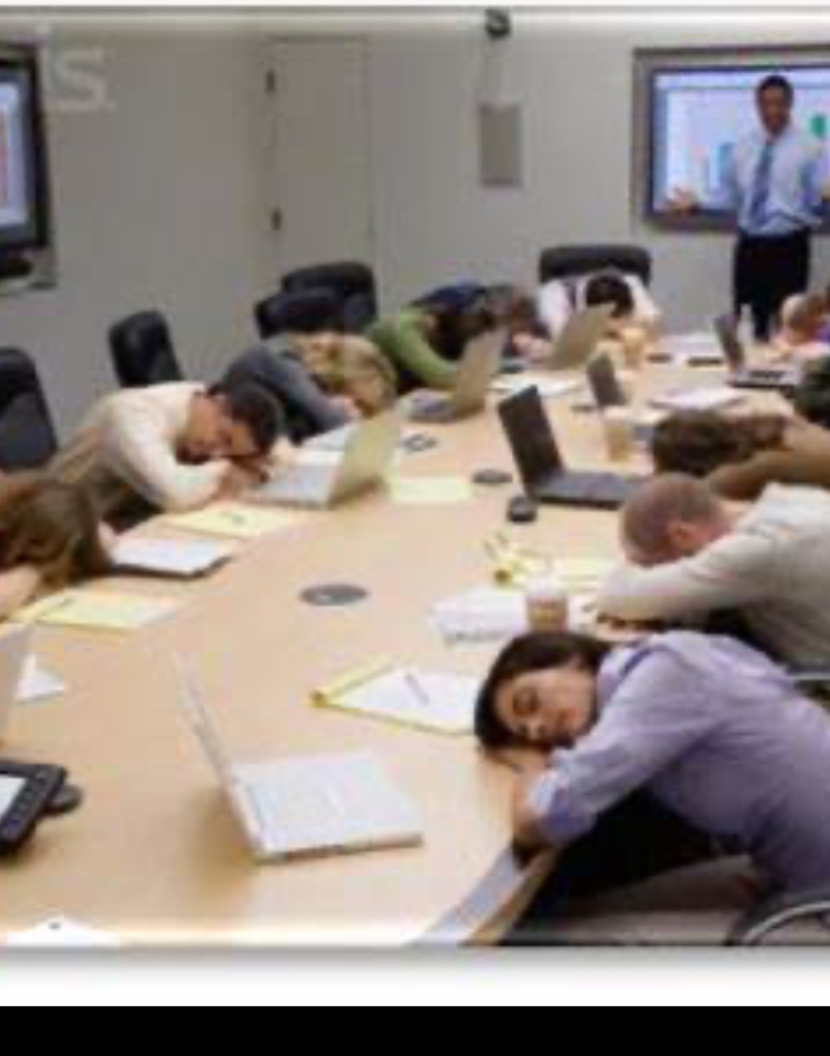
Who are Your Officers and Members ??
Are the ‘Workers’ Volunteers or Paid Staff? Can reduce workload
Keep Board and Members interested and engaged!!
Limit Board and Regular Meetings to a specific time.
Don’t attempt to give one or two members all of the work, even if they volunteer.
Look for the signs of ‘burnout’

Slide 6

Steps to Run a Successful Board Meeting
Define the Meeting Objectives
Create an Agenda and Send Calendar Invites
Determine a ‘safe’ location
STAY ON TRACK
End with Clear Actions, Timelines and Owners
This Photo by Unknown Author is licensed under CC BY-NC

Slide 7

Successful Chapters have a Business Plan
Plan of Action
Work Plan
Plan of Activities
Work Plan
Action Plan
Operational Plan
Business Road Map
Business Strategy
Call them what you wish but they are all examples of “BUSINESS PLANS”
“IF YOU FAIL TO PLAN, YOU PLAN TO FAIL”-Benjamin Franklin

Slide 8
Typical Business Plan Format Which may be drafted as “By-Laws”
Start with your Executive Summary
What is your chapter goals and why it will successful
Market Analysis
What or Who is your Target Audience (code officials, contractors, industry)
Why are you different than your competitors, (and how will you attract customers)
Organization and Management
How is your chapter structured and who are the leaders (are they elected, friends, appointed)
Financial Projections
Why and How will your Chapter be Viable
Financial Projections can be changed as the chapter grows

Slide 9

Establish a Budget for the Chapter / Business
What is a Budget?
A document that organizations use to track income and expenses in a detailed enough way to make operational decisions
1. Understand your organizations goals
2. Estimate your income for the period covered by your budget
3. Identify your expenses
4. Determine your surplus or deficit
Always try for a balanced budget (or at least a surplus)
This Photo by Unknown Author is licensed under CC BY

Slide 10
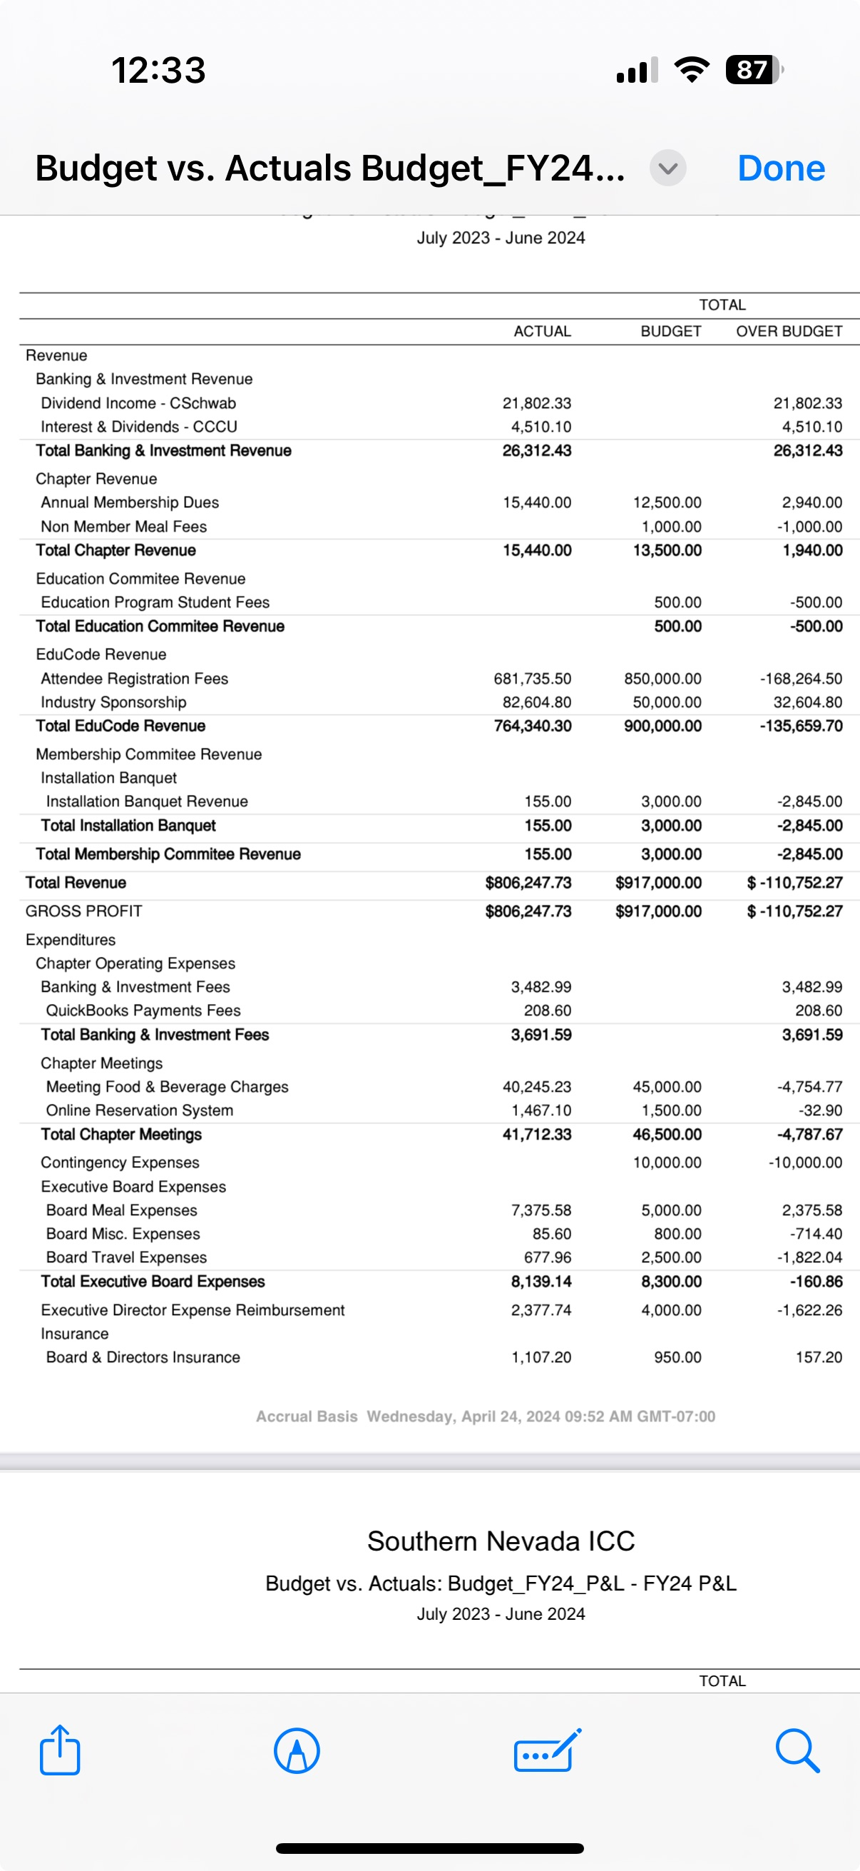
Budget Continued

Slide 11
Lessons Learned Through Experiences
IN THE BEGINNING…..SNICC was mostly a social organization
Chapter always spent more than anticipated – emotional spending…what is that??
Didn’t capture what members wanted -training
Needed to ‘fill this void’
Members wanted training and method for CEU’s without traveling as jurisdictions cut budgets
In 1998, EduCODE was born
A ‘committee’ of The Southern Nevada Chapter of ICC
The first year was scarry, but as long as SNICC broke even and met the needs of the members we were happy.
Since the first EduCode revenue and attendance (and costs) have greatly increased and do we run EduCode or does EduCode run us?
Were we prepared to go from a small ‘business’ to a large business? (Changes Made)

Slide 12

Lessons and Experiences (Continued)
The same model of EduCODE continued until 2021……Then what happened??
Pandemic happened and woke us up
Forced to Reevaluate-should have done that on our own
Is our model still practical?
What do people want? What can they Afford?
Why didn’t we see this ourselves?
We lost track of the actual mission, we became complacent
Always the question (why EduCODE?, venue? Price? Quality? Director?)
ALWAYS KEEP EVALUATING YOUR MISSION
How did we reevaluate and reanalyse??
This Photo by Unknown Author is licensed under CC BY

Slide 13
Successful Business / Chapters Models (Training) A very common Enterprise
Some Examples are (ICC Related)
SNICC uses EduCODE = support the Vision of the Southern Nevada Chapter
AZBO
WABO
CALBO
OBO
BOAT
BOAF
Anyone here from those chapters?
ALWAYS WATCH YOUR MARKET AND COMPETITION

Slide 14
Lessons Learned (Continued)
Reserves for Hard Times
Don’t over Commit
Cheap vs. Thifty
Clashes and Cliques

Slide 15
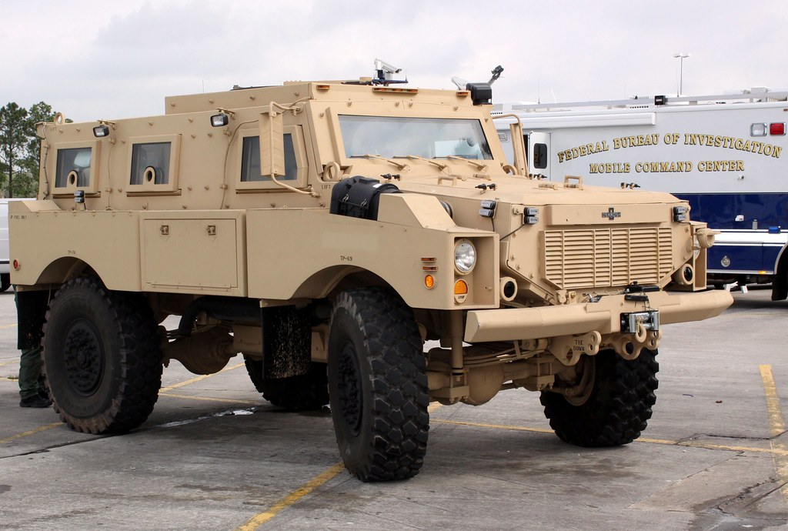
S. W. O. T. Analysis
Strengths (internal)
Weaknesses (internal)
Opportunities (external)
Threats (external)
Can these overlap???
This is an easy way to evaluate the effectiveness of your chapter and committees – other great analyses models are:
SOAR (strengths, opportunities, aspirations, results)
NOISE ( needs, opportunities, improvements, strengths, exceptions)
This Photo by Unknown Author is licensed under CC BY-SA-NC

Slide 16

Using EduCODE as an EXAMPLE…. Strengths
EduCODE is a ‘Brand’
EduCode is in Las Vegas
EduCODE is Reasonably Priced
EduCode is not Just Training
EduCode Director is a Great Guy?

Slide 17

Weaknesses
Venue
Class Content and Availability More ICC or less ICC??
Pricing
Virtual and In-person?
This Photo by Unknown Author is licensed under CC BY-NC-ND

Slide 18
Opportunities
Innovation – what’s next???
Expansion – Team up with other training organizations?
Marketing – utilize available resources- Social Media
Venue(s) live at one location and virtual at another?? Cancel Live?
More than one EduCode a year? East Coast?

Slide 19
Threats / Challenges
Other Training Opportunities Operating
Sacramento Valley, CalBO, Colorado, AZBO, WABO, BOAT, Region 3, ICC, IDABO and others
Increasing Costs
Venue
Volunteers – workloads from real jobs, families, aging workforce

Slide 20

Analysis of Analysis
Must something be done NOW??
How do we change the weaknesses to strengths?
Can the opportunities be capitalized on?
Does one change create another problem?
Overwhelming????
“In Life, Change is inevitable. In Business, Change is Vital.”
Warren G. Bennis

Slide 21

SUMMARY
Have a Vision and Mission Statement
Create a Business Plan
Understand Your Market
Watch Your Competition – Be Aware
Build a Strong Brand
Develop a Marketing Strategy
Adapt to Change
Be Organized and keep accurate Records
Use and Take Advantage of Technology

Slide 22


