Slide 1
Disaster Recovery Reform Act Section 1206
Building Code and Floodplain Management Ordinance
Administration and Enforcement
FEMA Policy FP 204-079-01 Training | July 2021
Policy Information and Implementation Guidance
Eddie Williams
Public Assistance Team Lead- Louisiana
FEMA Region 6 Public Assistance
Eddie.williams@fema.dhs.gov
Notes:
Title slide + Image Option 2

Slide 2
Authority and Purpose
Authorizes FEMA to provide funding to state and local governments for building code and floodplain administration and enforcement.
Policy is administered through the Public Assistance (PA) Program. (Note: Additional assistance may be available under Federal Insurance and Mitigation Administration [FIMA]).
Purpose
Provide communities with the resources needed to administer & enforce state and locally adopted building codes and floodplain management ordinances.

Slide 3
Principles
Increase the overall speed of recovery by providing financial assistance to conduct building inspections, review disaster-related development in the floodplain, and issue permits to administer and enforce adopted building codes and floodplain ordinances.
Enhance compliance with state and local building codes and floodplain management ordinances by providing state, tribal, territorial, and local governments additional resources to carry out required activities after a disaster.
Federal Emergency Management Agency

Slide 4
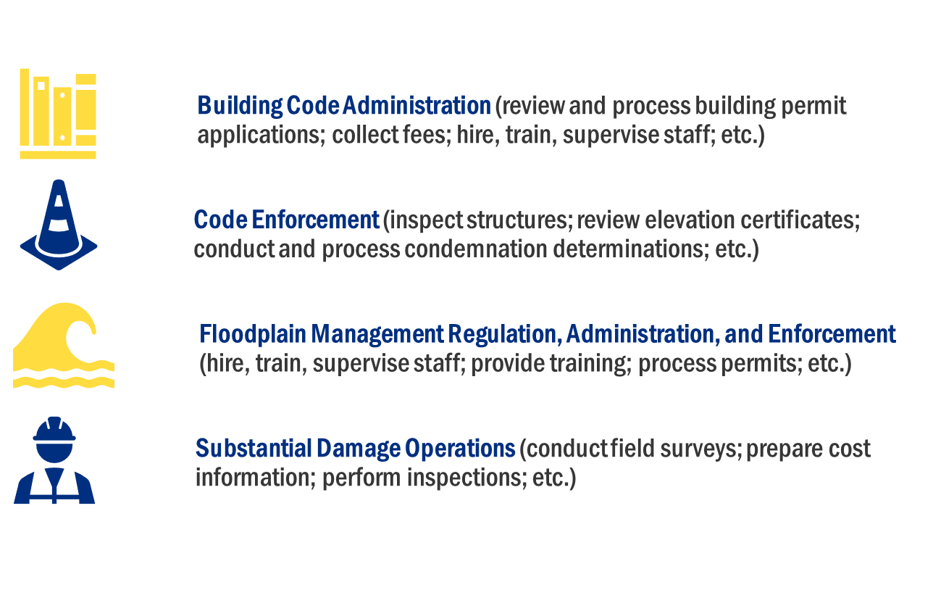
DRRA 1206 Authorizes FEMA to Provide Resources to State, Local, Tribal and Territorial Partners

Slide 5
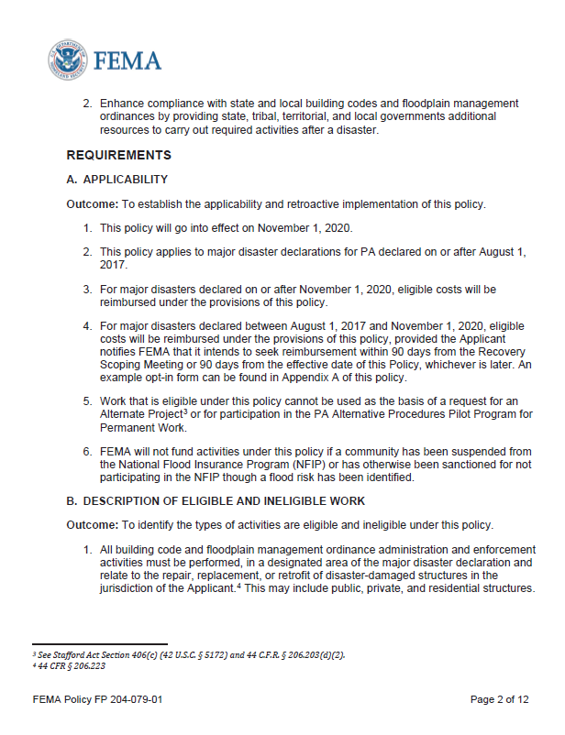
Work Eligibility Criteria
Must be:
Performed in a designated area of the major disaster declaration and;
Relate to the repair, replacement or retrofit of disaster-damaged structures (public, private and residential) in the jurisdiction of the Applicant.
Consistent with the work normally done to administer and enforce building codes.
Eligible under Category G (Permanent Work)

Slide 6
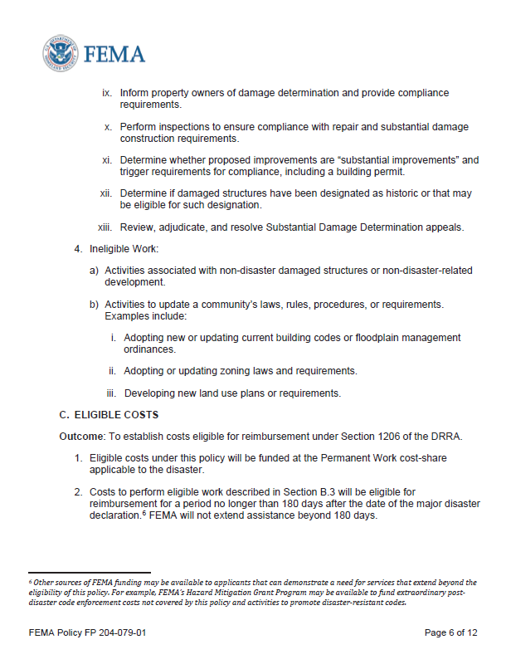
Cost Eligibility Criteria
Funded at the Permanent Work cost-share applicable to the event
Funding eligible for 180 days after major disaster declaration date
All claimed costs must be necessary and reasonable and are subject to program eligibility and other Federal requirements, including those related to procurement and contracting
PA prohibited from providing assistance that duplicates funding from another available program

Slide 7
Eligible Costs
Overtime for budgeted employees
Purchase of supplies and equipment to execute work is eligible
Straight and overtime for unbudgeted employees & extra hires
Mutual Aid or EMAC costs are eligible depending on agreement
Costs associated with temporary hires or contract support is eligible
Legal cost related to enforcing building code or floodplain ordinance
Other costs associated with extra hires or contracted support may be eligible for reimbursement. This includes costs for travel, accommodations, and per diem, as appropriate
Notes:
Note the eligible work bullets are not all-inclusive. For a longer list, please see the policy. Activities not listed in the policy will be evaluated on a case-by-case basis.

Slide 8
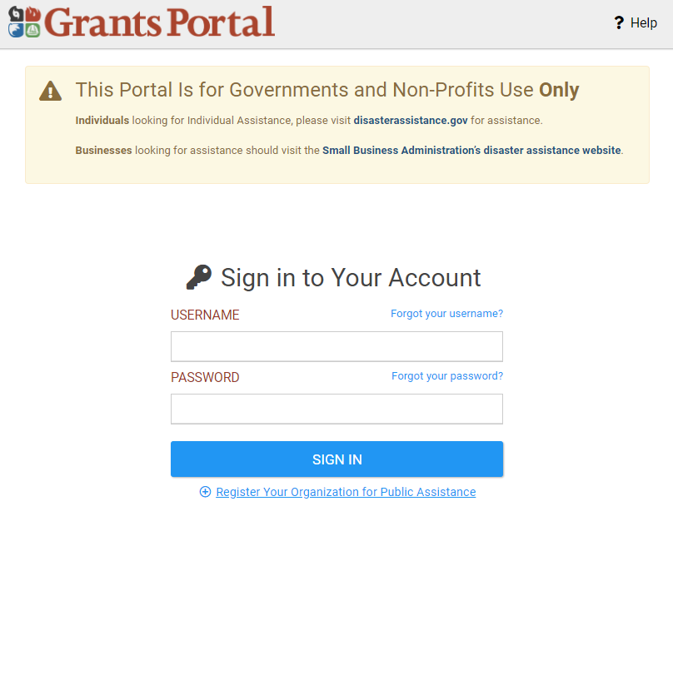
How Do Communities Apply?
Communities must submit their applications for reimbursement and all supporting documentation through the PA Grants Portal.
https://grantee.fema.gov/

Slide 9
Supporting Documentation Needed
Example of a timesheet needed for documentation.
Supporting documentation is needed:
Timesheets for actual costs incurred
Labor Policy
Any contractual agreements (including
EMAC)
Documentation demonstrating how
contract was procured
Equipment and Material logs
In addition, FEMA may require that the applicant provide documentation demonstrating that the eligible activities are in support of the community’s legally adopted building code or floodplain management ordinance.

Slide 10
What Happens Following Community Submission?
FEMA PA Program Delivery Manager (PDMG) will formulate a project.
PA Applicant and PDMG will work together to answer Essential Elements of Information (EEI) questions and gather appropriate documentation to substantiate eligibility of work and cost claimed.
PA PDMG will forward project to Consolidated Resource Center for processing.
Funding is obligated.
Once work is complete, Applicant will reconcile final costs and submit project and all supporting documentation to Recipient for closeout.
Recipient will reconcile final costs and review supporting documentation.
Recipient forwards closeout package to FEMA.
FEMA will review closeout package and supporting documentation. Any offsets that need to be taken will be addressed at that time.
FEMA will close the project worksheet (grant).

Slide 11
Suggested Next Steps for Communities
Floodplain administrators and/or building code officials should begin discussions with their Community Public Assistance POC about the policy.
Have a substantial damage plan in place.
Have contracts or agreements in place that meet federal procurement guidelines.
Familiarize yourself with Emergency Management Assistance Compacts (EMACs).
Organize documentation to request funding after the first 30 days of enforcement activities.
Then project the next 150 days of enforcement based on actual incurred and projected staff allocation and equipment usage.

