Slide 1
Being a Code Advocacy Leader
2024 Chapter Leadership Academy
Gabe Maser
Senior Vice President, Government Relations
April 5, 2024

Slide 2
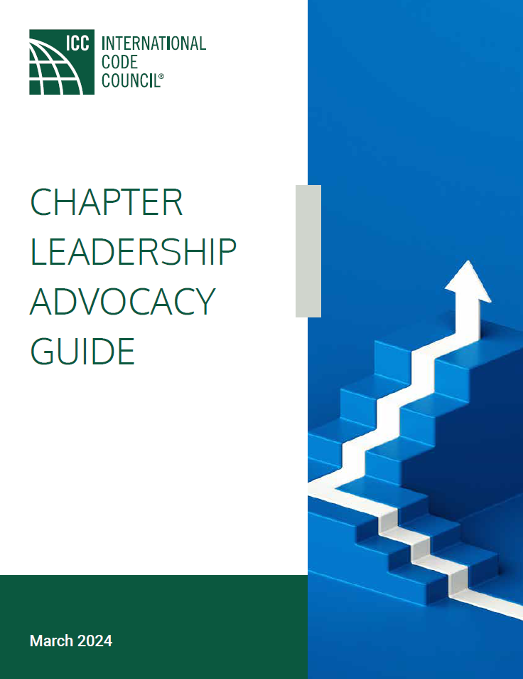
The Guide is a revamped primer/tool to assist leaders at all levels of experience
Iterative document that will be updated based on your input
Electronic/hard copies available

Slide 3
Why Should I Be a Code Advocacy Leader?
As a code professional, you are an integral part of your community because you affect the way the built environment is constructed, which protects lives and enables community growth
It’s critical that you and your colleagues keep tabs on policy development concerning code officials and create avenues to tell your stories to elected officials, other policymakers, and the general public so they appreciate your hard work/the importance of building safety, and write policy that furthers your efforts

Slide 4
So Where Do I Begin? Know Who Makes Decisions That Impact You and Your Community
Do you know who are your U.S. Senators?
Do you know who is your member of Congress?
Do you know who is your Governor?
Do you know who is your State Senator/Representative?
Do you know who is your Mayor/City Councilor/County Commissioner?

Slide 5
So Where Do I Begin? Be Aware, Get Engaged
Does your ICC chapter have a legislative/policy committee?
Who is involved in a chapter legislative committee? What works?
How do I start a legislative committee?
Find a few people interested in the legislative process
Partner with another group with similar interests – for instance: architects, engineers, fire marshals, municipal leagues, etc.
Determine areas of focus/priorities (funding, shot clocks, code rollbacks/delays, enforcement officer safety, recognition of your department’s value)
What priorities have your chapters identified?

Slide 6
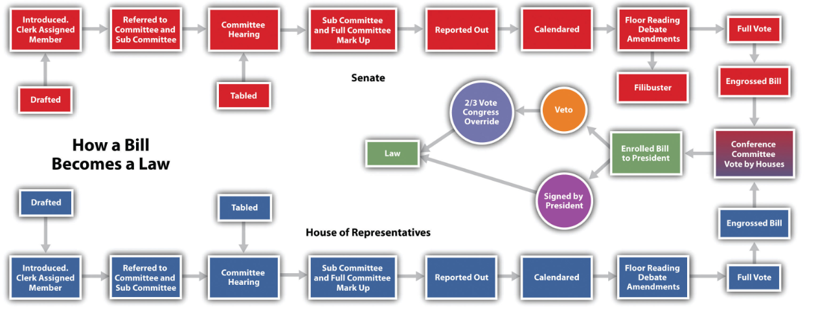
Legislative Entry Points

Slide 7
Regulatory Entry Points
Statute authorized rule
OMB/state analog review
Proposed rule published
Hearings/ public comment
Comments considered
OMB/state analog review
Final rule published
Judicial/ leg review
Idea

Slide 8
Telling Your Story If People Don’t Know, They Can’t Care
GOAL: Talk positively about how your department is protecting and contributing to the community and, based on that foundation, support your policy goals
Why?
The people who show up are the ones that get results.
Public officials are people like you, so don’t be intimidated to tell your story.
Don’t be shy! Telling your story is as easy as telling someone you had a good day at work because you saw a new, safe home being built down the street.

Slide 9
Communication Tools You Can Use Writing a Letter/Email
GOAL: Focused arguments written clearly, usually just a few paragraphs.
Answer the Who? Where? When? Why? and What?
Email is preferable because hard copy letters are often delayed

Slide 10
Communication Tools You Can Use Visiting a Policymaker
GOAL: Personal visits resonate with decision makers who now have a face and hometown story to put with an issue.
Who has participated in a chapter’s legislative/capitol event?
What worked? How did the day go? How did the meetings go?

Slide 11
Communication Tools You Can Use Hosting an Event
GOAL: Create an opportunity for policymakers and the public to learn more about the importance of your work and modern codes.
Who has hosted an event?
What worked? How did the day go? What was the benefit of the event?
Building Safety Month provides a ready-made opportunity to build an event for area policymakers that highlights your department/chapter’s efforts

Slide 12
Communication Tools You Can Use Public Relations
GOAL: Create an opportunity for policymakers and the public to learn more about the importance of your work and modern codes.
Who has implemented a public relations effort?
What’s worked for you? What benefits did you see?
Example PR: social media, press releases

Slide 13
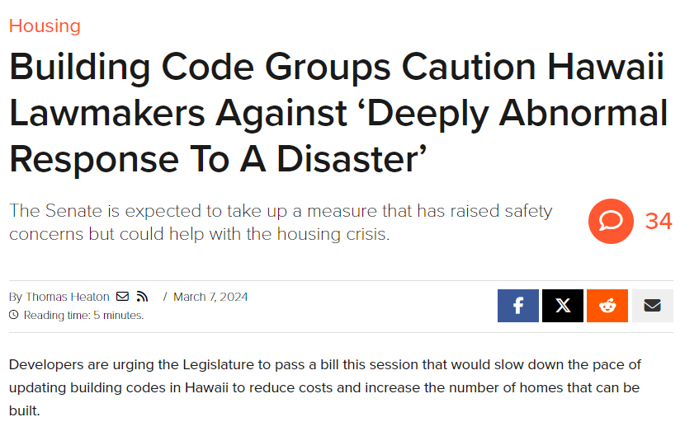
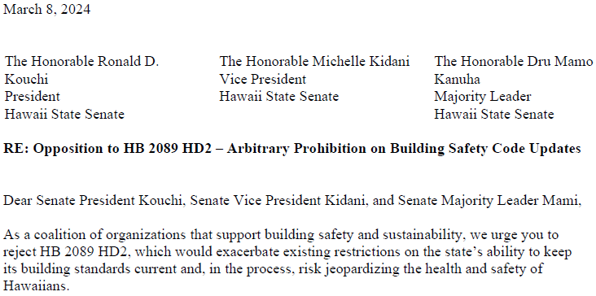
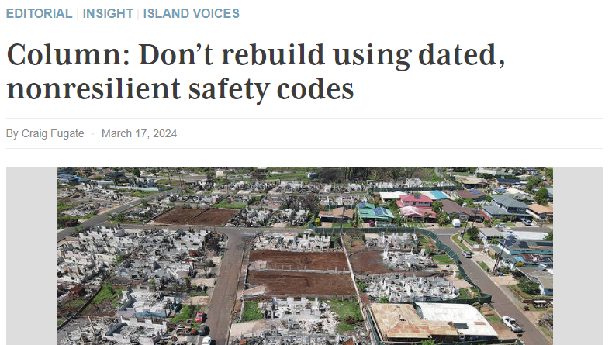
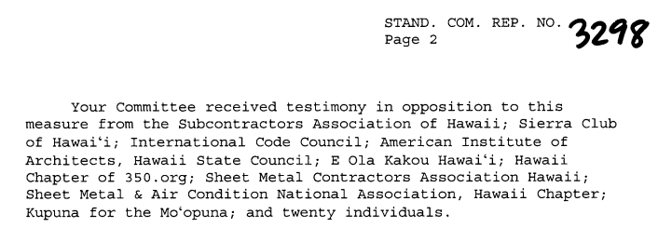
ICC-GR Advocacy in Action

Slide 14
Put ICC’s Government Relations Team to Work for You!
With backgrounds in elected office, state and local administrations, media, political consulting, and grassroots organizing, the ICC Government Relations staff can assist, answer questions, and serve as a sounding board to support your chapter’s legislative and regulatory engagement.
Visit the Government Relations webpage at www.iccsafe.org/advocacy to find the contact information for your local liaison.

Slide 15
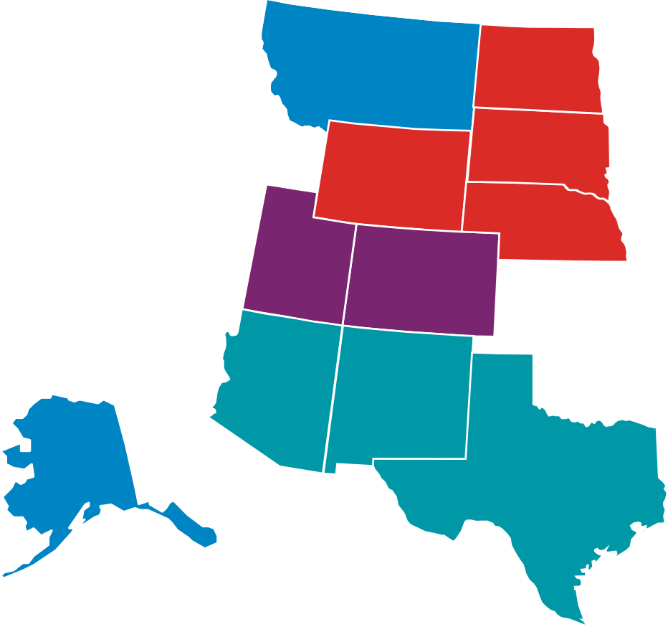
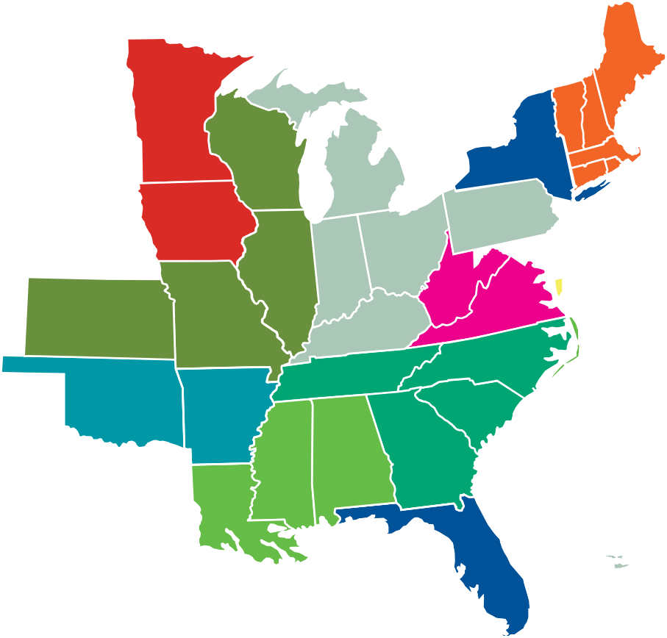
State and Local Areas of Responsibility
WASHINGTON
MAINE
MONTANA
NORTH DAKOTA
OREGON
MINNESOTA
VT
NH MASS.
IDAHO
SOUTH DAKOTA
WISCONSIN
MICHIGAN
NEW YORK
GUAM AND NORTHERN MARIANA
ISLANDS
WYOMING
CONN.
R.I.
NEBRASKA
IOWA
PENNSYLVANIA
NEVADA
INDIANA
OHIO
DEL.
UTAH
ILLINOIS
W.VA
CALIFORNIA
COLORADO
KANSAS
MISSOURI
VIRGINIA
KENTUCKY
NORTH CAROLINA
AMERICAN SAMOA
ARKANSAS
TENNESSEE
SOUTH
ARIZONA
NEW MEXICO
OKLAHOMA
CAROLINA
GEORGIA
MISS. ALABAMA
ALASKA
TEXAS
LOUISIANA
PUERTO RICO
HAWAII
FLORIDA
US VIRGIN ISLANDS
CAYMAN ISLANDS
Corey Roblee, OH Office Dorothy Mazzarella, FL Office Kraig Stevenson, WA Office Karyn Beebe, S. CA Office
Bill Nash, RI Office
Tim Schmitz, IL Office
Rick Hauffe, SD Office Alyssa Misiewicz, DC Office Mark Roberts, LA Office Rick Bluntzer, TX Office
Stephen Jones, SC Office Lisa Berger, DC Office Lesley Garland, N. CA Office
23-22908

