Slide 1
National Association of Home Builders In Support of Appeal (Online Voting and Voter Eligibility)
ICC APPEAL HEARINGS | September 14, 2020
NAHB Representatives:
S. Craig Drumheller
Presentation of Appeal by:
Megan H. Berge
Baker Botts L.L.P.

Slide 2
Presentation Overview
Board of Appeals Review
ICC Board Authority and Duty
Summary of Issues
Online Voting & Voter Eligibility
Impacts on 2019 Group B Code Development Cycle
Procedural Implications
Requested Remedies

Slide 3
Board of Appeals Review
Scope of Review (6.3.7):
Includes “matters of process and procedure”
Excludes “decisions on the relative merits of technical matters”
Basis for Action (6.3.8):
Any “material and significant irregularity of process or procedure”
Allowed Actions (6.3.9):
Board of Appeals may “fashion any remedy it deems appropriate”

Slide 4
ICC Board Authority and Duty
Voting Irregularities (10.2):
“Where voting irregularities or other concerns with the Online Governmental Consensus Voting process which are material to the outcome or the disposition of a code change proposal(s) are identified by the validation committee, such irregularities or concerns shall be immediately brought to the attention of the ICC Board. The ICC Board shall take whatever action necessary to ensure a fair and impartial Final Action vote on all code change proposals . . . .”
ICC Board Action (13.1):
“[T]he ICC Board may take any actions it deems necessary to maintain the integrity of the code development process.”

Slide 5
Summary of Issues
The eligibility criteria for participating in the Online Governmental Consensus Vote (“OGCV”) are too broad.
The 2019 Group B Code Development Cycle included voting irregularities and other concerns that were material.

Slide 6
The eligibility criteria for participating
in the OGCV are too broad.

Slide 7
The OGCV Eligibility Criteria Are Too Broad
ICC Bylaws on “Governmental Member” (2.1.1):
“A Governmental Member shall be a governmental unit, department or agency engaged in the administration, formulation, implementation or enforcement of laws, ordinances, rules or regulations relating to the public health, safety and welfare.”
ICC Bylaws on “Governmental Member Voting Representatives” (2.1.1.1):
“Governmental Member Voting Representatives shall be . . . employees or officials of the Governmental Member or departments of the Governmental Member, provided that each of the designated voting representatives shall be an employee or a public official actively engaged either full or part time, in the administration, formulation, implementation or enforcement of laws, ordinances, rules or regulations relating to the public health, safety and welfare.”
Can you think of a governmental function that does not implicate public health, safety, or welfare?

Slide 8
Overbroad OGCV Eligibility Criteria Conflict With ANSI U.S. Standards Strategy
CP#28-05, Section 1.4 (Process Maintenance):
“The manner in which Codes are developed embodies core principles of the organization.”
ICC 2019 Report:
“The International Code Council’s code development process is consensus-based and founded on principles of due process and transparency,” and “meets the principles defined by the National Standards Strategy of 2000.”
ANSI’s U.S. Standards Strategy:
Globally accepted principles of standards development must include:
Transparency- Essential information regarding standardization activities is accessible to all interested parties.
Impartiality- No one interest should dominate the process or be favored over another.
Consensus- Decisions are reached through consensus through those affected.
Due Process- All views must be considered

Slide 9
Overbroad OGCV Eligibility Criteria Conflict With ICC Core Principles
Openness & Transparency
Recruiters can monopolize influence over undisclosed voting representatives
Participants have limited/no opportunity to influence these persons
Balance of Interests (Impartiality)
ICC code development committees provide a balance of interests
OGCV recruitment eliminates this balance (both from the type of governmental unit they represent and geographically)
Due Process
Proposals that are not fully vetted in the Public Comment Hearing can continue in the process.
Lack of equal access to voting representitives
The International Codes are to be:
Efficient and effective, economically viable and practical, and not influenced by vested financial interests
OGCV allows supermajority to bypass these and other principles
Source

Slide 10
An Easy Recruitment Contest
Department of A
Interest Group
Department of B
Mayor
Department of C
Department of D
Department of E

Slide 11
Not a Hypothetical Scenario
Boston:
City Council
Climate & Energy Department
Inspectional Services Department
Planning & Development Agency
Public Facilities Department
Public Works Department
Water and Sewer Commission
Newton:
City Council
Inspection Services
Planning Department
Planning Board
Public Buildings Department
Zoning Board of Appeals
Design Review Committee
Designer Selection Committee and Sustainability
Citizens Commission on Energy

Slide 12
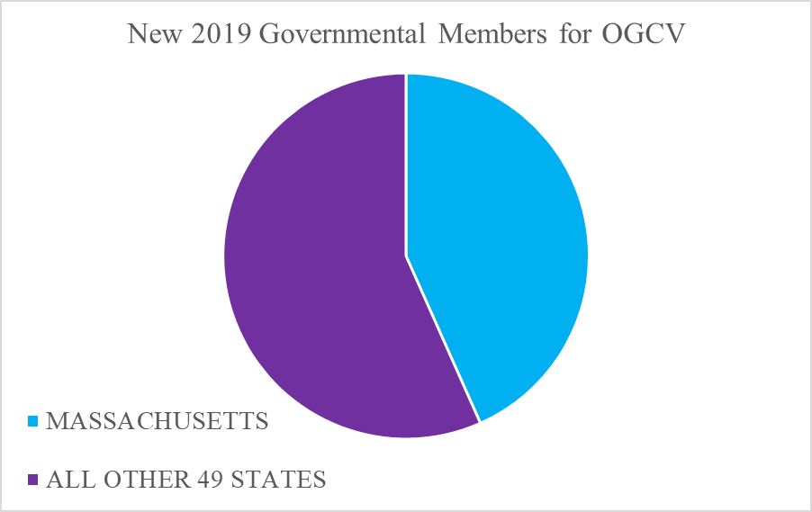
Imbalanced Recruitment

Slide 13
Unintended Consequences
Allows for persons without knowledge or experience with building energy codes to influence (if not dictate) outcomes
Transforms an informed process that produces feasible model code provisions into a recruitment contest
Invites the adoption of radical versus rational code change proposals

Slide 14
“Yes, the Bylaws’ Definitions Have Been Around for a While”
In the past, necessary participation in multiday hearings provided a self-correcting process. Persons participating were:
Vested members
Frequent users of the code
Those who understood the relevance of the proposed requirements
Present for the hearing discussions
Past process ensured:
Subject knowledge and expertise
Actual deliberation → exchange and scrutinizing of ideas
Informed decision-making
People who used the codes decided on the codes

Slide 15
The 2019 Group B Code Development Cycle included voting irregularities and other concerns that were material.

Slide 16
20 Code Change Proposals
Twenty proposals were disapproved twice
Committee Action Hearing
Public Comment Hearing
Still passed because of supermajority override
Included RE126 (serious legal concerns due to preemption)
Included CE217 Part II and RE147 (exceeds IECC scope and intent)
With a supermajority voting bloc, there is no need to have hearings at all.

Slide 17
ICC Report on the Code Development Process 2019 Group B Cycle
“A staff review of the OGCV since its inception in 2014 has confirmed that the pattern of voting identified in the letter as an irregularity – disapproved at the CAH, disapproved at the PCH, then passed during the OGCV – has not occurred previous to this current cycle.”
Report concluded that no impermissible “voting irregularities occurred” because “pattern of voting [was] not prohibited in CP 28,” and “is provided for in Section 8.1.”
Report interpreted CP#28-05, Section 10.2 too narrowly. A voting irregularity or other concerns that are material to sustain an appeal may exist even where technical compliance occurred.
Source

Slide 18
Objective Evidence of Material Voting Irregularities
Inexperienced voters participating
Massive increase in voting representative applications
Large number of last-minute applications
Widespread use of a single voter guide
Inflammatory and over-simplified descriptions in voter guide
No requirement to be knowledgeable or involved in the weeks-long technical code development process
Confirmed unprecedented and anomalous voting results

Slide 19
Procedural Implications Under CP #28-05
Voting Irregularities (10.2):
“Where voting irregularities or other concerns with the Online Governmental Consensus Voting process which are material to the outcome or the disposition of a code change proposal(s) are identified by the validation committee, such irregularities or concerns shall be immediately brought to the attention of the ICC Board. The ICC Board shall take whatever action necessary to ensure a fair and impartial Final Action vote on all code change proposals . . .”
ICC Board Action on Violations (13.1):
“Additionally, the ICC Board may take any actions it deems necessary to maintain the integrity of the code development process.”

Slide 20
Requested Remedies: Steps to a Credible Model Code
Set aside the voting results of the 20 code change proposals
Revise CP#28-05
Clarify that proposals disapproved at both Committee Action Hearing and Public Comment Hearing cannot be overturned by the OGCV
Revise the Bylaws
Adopt sensible limits in the definitions to prevent recruitment races
Potentially limit voting to those who apply the building codes
Any action that the ICC Board deems necessary to maintain the model code’s credibility
A code development process that is driven by expertise

