Slide 1
Opposition to LBA & NAHB
Appeals on Energy Issues
Comments provided by Jake Pauls, BArch, CPE, HonDSc
Jake Pauls Consulting Services
Silver Spring, MD & Toronto, Canada
77-year old, ICC Member for over two decades, with
280 committee-years of codes & standards development
experience in the USA, including—currently—2 ICC committees
(IAC & A117), 11 NFPA committees, and 4 on other organizations’ standards. On ten committees Jake formally represents the American Public Health Association, APHA.

Slide 2
Opposition to LBA & NAHB
Appeals on Energy Issues
Comments provided by Jake Pauls, BArch, CPE, HonDSc
Jake Pauls Consulting Services
Silver Spring, MD & Toronto, Canada
Brief Summary of Professional Opinions in Comments
Stated succinctly, the ICC process worked as intended. Voting Members exercised their rights to set aside the recommendations from flawed or otherwise inadequate Committee Action and Public Comment Hearings to address major societal problems. Voting members apparently used evidence and exercised ethical attention to their duties as representatives of the public, in organizations relied upon to preserve public health and safety.

Slide 3
Basis for Professional Opinions in Comments:
1961: my work in building design, construction,
use, and related standards/codes fields included
surveying, engineering, construction, research and consulting.
Some of this overlapped with nine years of University study in physics, engineering, and architecture completed in 1969.
1967: 20-year career began in building use & safety research.
1970: All work, henceforth, was international in scope.
1987: Began 33-year, US-based, building-related consulting.
2017: University of Greenwich, UK, conferred an Honorary Doctor of Science; this came from the Faculty responsible for Architecture, Building Studies, Evacuation research, etc.
2019: Two home-based offices: Silver Spring, MD and Toronto

Slide 4
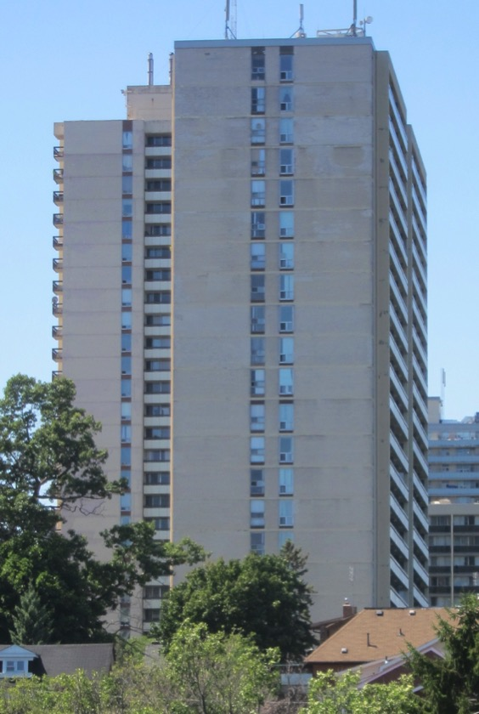
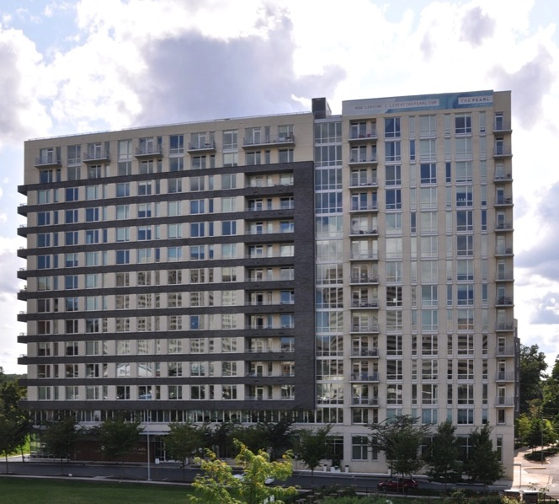
Jake Pauls’ Apt.-based offices
#2207 in Toronto, Canada
#1007 in Silver Spring, MD
New
c.1970
New
2017

Slide 5
Jake Pauls’ Apt.-based offices
#2207 in Toronto, Canada
#1007 in Silver Spring, MD
New
c.1970
Interior area
690 sq.ft.
New
2017
Interior area
575 sq.ft.

Slide 6
Jake Pauls’ Apt.-based offices
#2207 in Toronto, Canada
#1007 in Silver Spring, MD
New
c.1970
4-Month
Summer Energy Cost:
USD 0.68 per sq.ft.
New
2017
Both
have
comparable
sun
exposure
but MD
is hotter.
4-Month
Summer Energy Cost:
USD 0.56 per sq.ft.

Slide 7
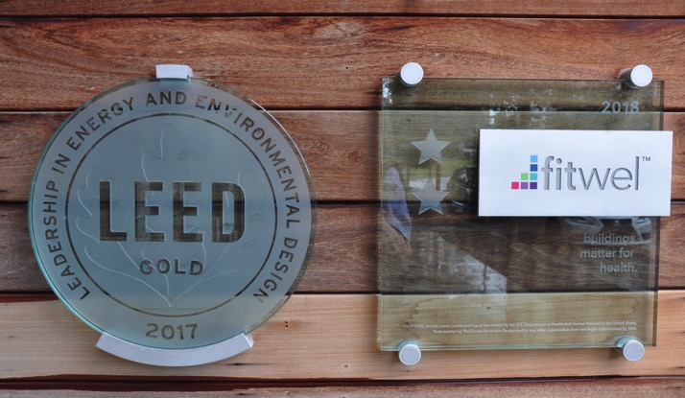
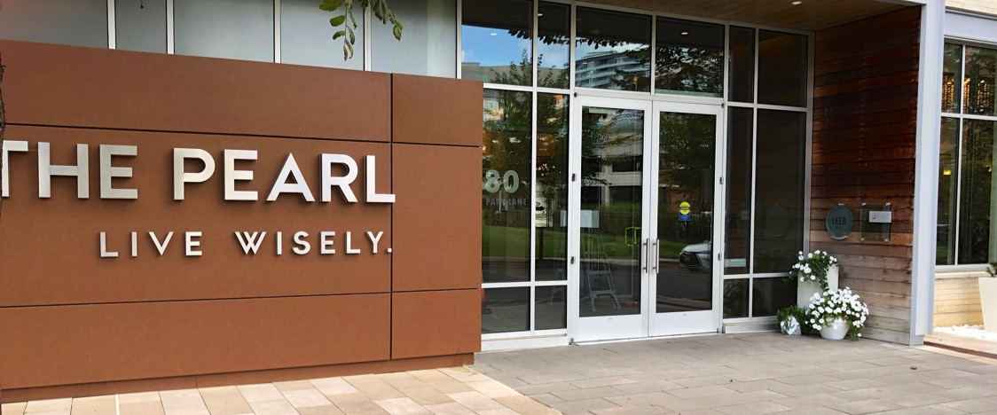
Jake Pauls’ Apt.-based office
in The Pearl, Silver Spring, MD
Part of living “wisely“ at
The Pearl is encouraging
everyone to care about
the entire environment.

Slide 8
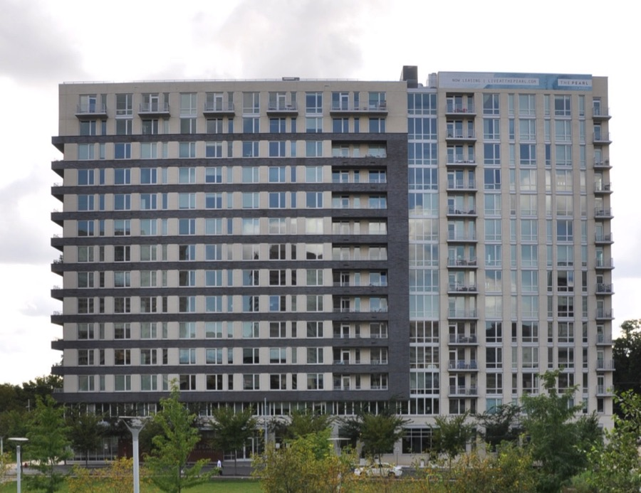
Jake Pauls’ Apt.-based office
in The Pearl, Silver Spring, MD

Slide 9
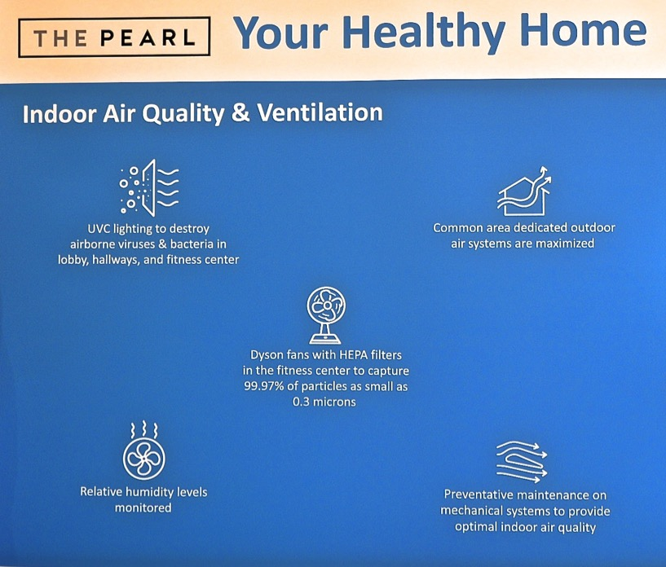
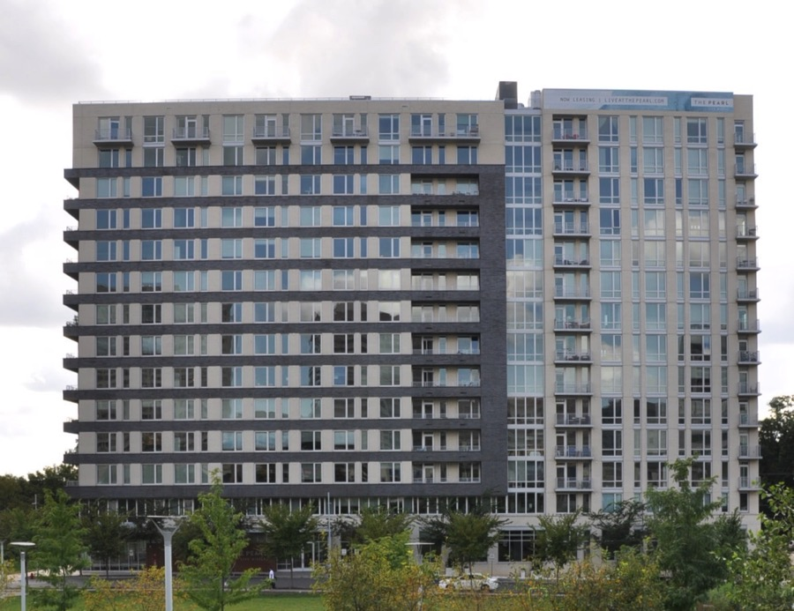
Jake Pauls’ Apt.-based office
in The Pearl, Silver Spring, MD

Slide 10
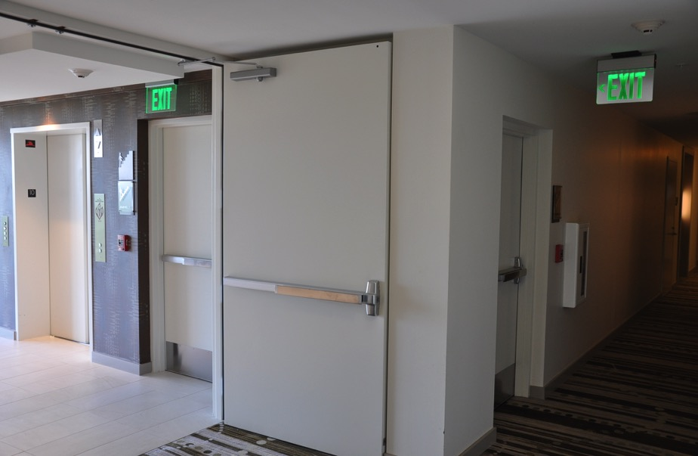
Jake Pauls’ Apt.-based office
in The Pearl, Silver Spring, MD
Beyond being a leader in efficient energy use;
building safety is state-of-the-art as well, including all its stairways and elevators.

Slide 11
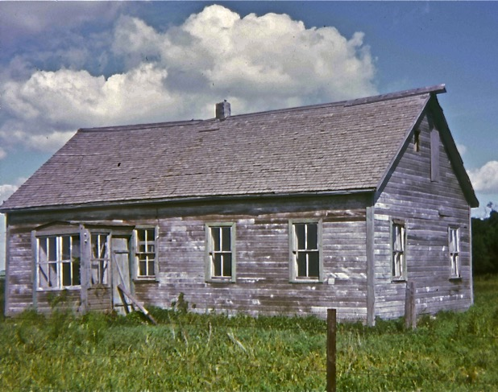
Built c.1920 by/for my grandfather in the northern Canadian prairies, this is the first house for which I have memories—beyond being born here. My grandmother raised 12 of her own children here as well as a few grandchildren. It was totally “off the grid” in relation to electricity.

Slide 12
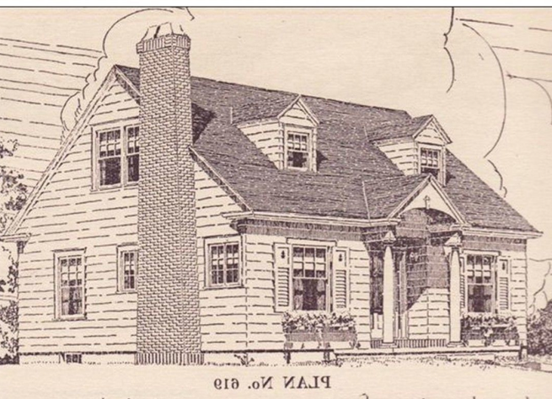
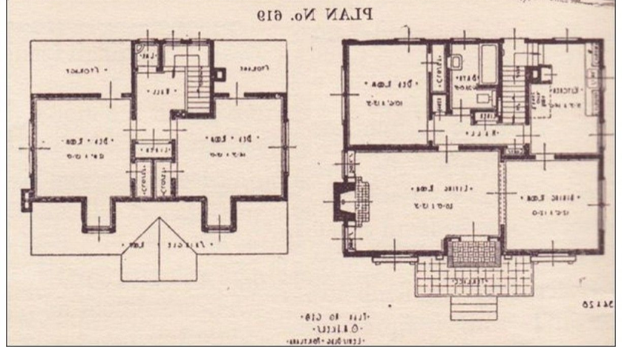
Over the last 70 years in the USA, beginning with Levittown NY homes, c.1950, homes—shown here with about 1500 sq ft—had as little as 700 sq ft. This rapidly expanded by more than 1200 sq ft in average size by 2000, according to NAHB.
Note that, if built to NAHB-touted dimensions, home stairways today are currently no better than this 1950s home had despite huge size increases of homes over several decades—despite injury statistics and research showing their gave dangers.

Slide 13
I would be one of the last persons ever asserting that home builders give sufficient attention to public health and safety in relation to very large societal issues such as stairway usability and safety plus the grave threats posed by global climate
change.
The proponents, including those in the Energy Efficient Codes Coalition (EECC), of changes to new home energy conservation, etc., with improvements t I-Codes, have done something historic, remarkable, and increasingly crucial given the wide range of news from the USA and beyond on what is happening to our treasured environment, including destruction of our homes, livelihoods and recreational opportunities by the traditional four dangers of earth, air, fire and water.
I applaud the proponents efforts which, I hope, will have long lasting effects, not only with saving our planet, but in forcing the leadership of ICC to reconsider its two-plus decades of operating with an overly cozy relationship to home builders, especially the National Association of Home Builders, NAHB (and, now, LBA also).

Slide 14
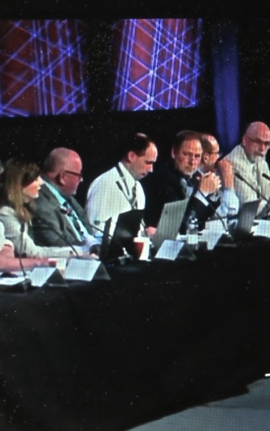
Over the two-decade-plus history of the ICC, there has not —reportedly—been a comparable instance of ICC voting members exhibiting their power in opposition to the smaller number of proponents, code development committee members and the relatively small proportion of voting ICC members able to attend, and vote at, hearings.
Thus, it is healthy to see the Governmental voting process being used to make up for the largely, industry-dominated hearings, especially the Committee Action Hearings (CAH) where NAHB needs to only convince 25 percent of other Cttee. members to reject proposals that NAHB opposes.
Other proponents need to convince 75 percent of the non-NAHB Cttee. members to allow a proposal to proceed to the Public Comment Hearing without having to get two-thirds of the assembly to even allow comment discussion.

Slide 16
ICC CP 2-05 - PARTNERSHIP DEVELOPMENT GUIDELINES
“. . . . To achieve the ICC’s vision and mission, the organization must continue to build relationships with external organizations that share or support the ICC’s purpose.
Vision
Protecting the health, safety, and welfare of
people by creating better buildings and safer communities
Mission
Providing the highest quality codes, standards, products, and services for all concerned
with the safety and performance of
the built environment”
Comment: From my public health role, as a bridge among several disciplines, I know the public is being very badly served by what the ICC Board and NAHB are doing. See next pages for details of the ICC-NAHB partnership.

Slide 17
ICC CP 2-05 - PARTNERSHIP DEVELOPMENT GUIDELINES
“1.1 Strategic Partner – A strategic partner is a high-level cooperative arrangement between a
named organization and the ICC. The purpose is generally to use the combined strengths of
both organizations to achieve the vision and mission of the ICC as well as to benefit the
strategic partnership. Strategic partners have publicly stated their support for the I-codes and
consistently lend their resources to achieving code adoptions at many levels. . . . To be successful, these partnerships require regular and consistent communication between the leadership of the originations (sic), which the ICC is committed to.”
Comment: If the partnership is “to achieve the vision and mission of the ICC” and NAHB has not supported the stronger I-codes—e.g., with new home stairs, and now with energy requirements, this partnership must surely be questioned.

Slide 18
ICC CP 2-05 - PARTNERSHIP DEVELOPMENT GUIDELINES
“Attachment A
The following list includes current strategic partners
and supporting and participating organizations. With
their support, the ICC’s vision, mission, and consensus process are working to improve safety in the built
environment.
Strategic Partners
American Institute of Architects (AIA)
National Association of Home Builders (NAHB)
National Multi Housing Council (NMHC)
Building Owners and Managers Association (BOMA)”
Comment: NAHB has not supported ICC’s
vision, mission and consensus process for decades. The following table lists many topics where NAHB is working against the public interest with ethically unfair and potentially illegal methods.

Slide 19
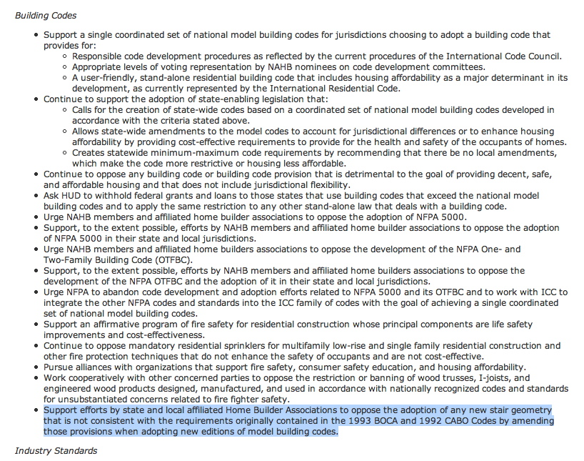
NAHB Policies dated 09/11/08 on Building Codes
1
2
NAHB Policies dated 09/11/08 on Codes from both ICC & NFPA.
See following enlarged texts of first six numbered items that explicitly note “affordability,” “affordable” or “cost- effective”
3
4
5
6
7
(implicit in # 7).

Slide 20
“1. Support a single coordinated set of national
model building codes for jurisdictions choosing
to adopt a building code that provides for:
Responsible code development procedures as reflected by the current procedures of the International Code Council.
Appropriate levels of voting representation by NAHB nominees on code development committees.
A user-friendly, stand-alone residential building code that includes housing affordability as a major determinant in its development, as currently represented by the International Residential Code.”

Slide 21
2 “Continue to support the adoption of state-
enabling legislation that:
calls for the creation of state-wide codes based on a coordinated set of national model building codes developed in accordance with the criteria stated above.
allows state-wide amendments to the model codes to account for jurisdictional differences or to enhance housing affordability by providing cost-effective requirements to provide for the health and safety of the occupants of homes.
Creates statewide minimum-maximum code requirements by recommending that there be no local amendments, which make the code more restrictive or housing less affordable.”

Slide 22
3 “Continue to oppose any building code or building code provision that is detrimental to the goal of providing decent, safe,
and affordable housing and that does not include jurisdictional flexibility.”
Here it should be noted that “the purpose” of Leading Builders of America (LBA) “is to preserve home affordability for American families.” This reflects a large overlap in the agendas of NAHB and LBA.
Decisions made by builders over the last seventy years in the US have increased single-family, detached home size by a factor by 100% or more (Ref: c. 1950 Levittown homes of 700 sq.ft. area)

Slide 23
4 “Support an affirmative program of fire safety for residential construction whose principal components are life safety improvements and cost effectiveness.”
The term “cost effectiveness” is used incorrectly if not hypocritically by home builders. (Stairway railing systems most often installed in homes are prime example of bad cost effectiveness.)

Slide 24
5. “Continue to oppose mandatory residential sprinklers for multifamily low-rise and single family residential construction and other fire protection techniques that do not enhance the safety of occupants and are not cost-effective.”

Slide 25
6. “Pursue alliances with organizations that support fire safety, consumer safety education, and housing affordability.”
Clearly, Leading Builders of America (LBA) is allied with the National Association of Home Builders (NAHB) on the matter of “housing affordability.”
A ‘bottom line’ observation is that builders’ make decisions that affect affordability negatively, for example by building in areas prone to climate change-triggered catastrophic events

Slide 26
7. “Support efforts by state and local affiliated
Home Builder Associations to oppose the
adoption of any new stair geometry that is not consistent with the requirements originally contained in the 1993 BOCA and 1992 CABO Codes by amending those provisions when adopting new editions of model building codes.”
#7, the last one in NAHB’s 2008 Policy on “Industry Standards,” is the earliest (i.e., 1996) and clearly most flawed in terms of public safety impact. NAHB calls for continuation of the 8.25 inch max. rise and min. 9-inch run dimension, a geometry that is clearly among the most unsafe—with a risk of serious injury 5.5 times greater than predicted with NFPA 5000’s “7-11” home step rule.

Slide 27
Money is said to be “the root of all evil.” Within the ICC code development process, if not an evil, money—or more generally “economics”—is very badly handled in CP28, especially Section 3.3.5.6 on “Cost Impact.”
The current ICC-IAC Work Group on this topic—on which I serve—is identifying, for ICC Board attention, how very inadequate this Section is. Cost impact—whether it pertains to safety or energy use—has to be considered in a balanced fashion with attention given to not only cost of implementation, but also to the benefits achieved. Benefit-Cost Analysis experts (in Economics) regard this approach as essential. Now ICC has to either improve CP28 or be seen as naïve on such an important matter.
ICC CP28 has to recognize that “Cost Impact” by itself may be
necessary, but it is not sufficient. Only an unbiased Benefit-Cost Analysis will be helpful in valid merit assessment of code proposals

Slide 28
Failure by ICC committees, as well as some ICC members, to recognize the current inadequacy in CP28, Section 3.3.5.6 on “Cost Impact” might well be a central issue in what happened with the energy proposals, the subjects of the NAHB and LBA appeals.
There is an excellent primer on what is needed in place of ICC’s totally inadequate “Cost Impact” section in CP28. Written by nearly 20 of the world’s top experts in Benefit-Cost Analysis, it has the title, “Consumer’s Guide to Regulatory Impact Analysis: Ten Tips for Being an Informed Policymaker,” Journal of Benefit Cost Analysis 2017; 8(2):187–204. Mike Pfeiffer has a PDF copy of this.
ICC CP28 has to recognize that “Cost Impact” by itself may be
necessary, but it is not sufficient. Only an unbiased Benefit-Cost Analysis will be helpful in merit assessment of proposals.

Slide 29
“1. Core problem: Determine whether the RIA identifies the core problem (compelling public need) the regulation is intended to address.
2. Alternatives: Look for an objective, policy-neutral evaluation of the relative merits of reasonable alternatives.
3. Baseline: Check whether the RIA presents a reasonable “counterfactual” against which benefits and costs are measured.
4. Increments: Evaluate whether totals and averages obscure relevant distinctions and trade-offs.”
RIA, Regulatory Impact Analysis is one type of BCA, Benefit-Cost Analysis. Whatever ICC prefers to call it, it must go well beyond its current narrow “Cost Impact” label and scope.

Slide 30
“5. Uncertainty: Recognize that all estimates involve uncertainty, and ask what effect key assumptions, data, and models have on those estimates.
6. Transparency: Look for transparency and objectivity of analytical inputs.
7. Benefits: Examine how projected benefits relate to stated objectives.
8. Costs: Understand what costs are included.
9. Distribution: Consider how benefits and costs are distributed.
10. Symmetrical treatment: Ensure that benefits and costs are presented symmetrically.”

Slide 31
Example of Detail Needed
10. “Symmetrical treatment: Ensure that benefits
and costs are presented symmetrically
One should pay attention to how benefits and costs are measured. For example, both should be measured from the same baseline and over the same time frame. . . .
Are the boundaries of the analysis framed symmetrically? No analysis will ever be complete, of course. However, major elements should not be missing on one side
of the equation, or overemphasized on another. For example, if the analysis presents evidence of co-benefits, are ancillary costs or countervailing risks examined to the
same extent?”

Slide 32
There are consequences to the policy, process and procedure decisions facing the leadership of ICC.
For home stairway-related injuries annually in the USA, the societal costs exceed 100 billion dollars each year, with 90 percent of the injuries occurring in homes. All ages are impacted.
Energy saving and Global Climate Change are on the order of trillions of dollars, although the loss of human society is beyond such valuations.
s
ICC, with its modest reserve fund of a few tens of millions of dollars, needs to act responsibly now.
The foregoing are the professional opinions of Jake Pauls. Comments are welcomed at bldguse@aol.com.
For further information see
www.bldguse.com

