Slide 1
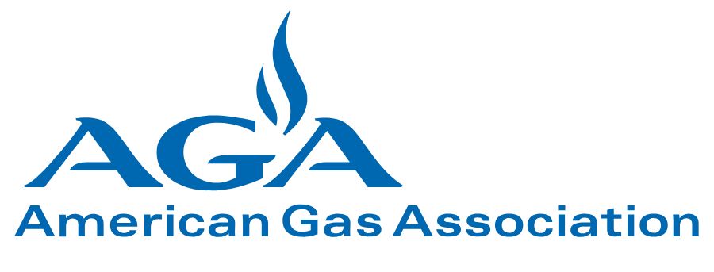

AGA and APGA Appeals of Final Standards Actions on the IECC, Proposals RE107-19 and RE126-19: Issues of Federal Preemption
Presenters: James A. Ranfone, American Gas Association
Renee Lani, American Public Gas Association
Ted Williams, American Gas Association
August 28, 2020

Slide 2
Underlining Principles of the AGA/APGA Appeal
Issues Raised in the Appeal Deal with Staff Process, Not Requirements Outcomes of These Two Proposals
These Issues are Associated with the ICC Process for Considering Proposals that Violate Federal Statute, Not Staff Behaviors or Conduct
Collectively, ICC Should Not Have Proceeded with Processing These Proposals, Given:
  The Record on Past Information on Federally Preempted Appliance Efficiencies Before ICC, and
  Burdens of Not Adhering to Prohibited Promulgation of Efficiencies in the International Energy Conservation Code (IECC) Upon Adopting Jurisdictions.

Slide 3
RE107-19: Salient Issues
Banning Continuously Burning Pilot Lights, which Results in a De Facto Ban of Standing Pilot Ignition of Gas-Fired Appliances, is in Conflict with Federal Law that Pre-Empts Promulgation of Requirements that Conflict with Federal Minimum Efficiency Standards for Products “Covered” by the Energy Policy and Conservation Act (EPCA) of 1975.
Arguments Presented by the Air-Conditioning, Heating and Refrigeration Institute (AHRI) for this Proposal and RE126-19 Explore in Detail the Legal Issues of Neglecting the Federal Preemption in Terms of Statutory Requirements
AGA Analysis of the Congressional Record Specifically Cites the Relevance of Federal Preemption of Banning Pilot Ignition
The Net Effect of the ICC Not Dismissing Proposals that Violate Federal Preemption is to Place the Burden of Legal Interpretation and Possible Federal Violations Down to the Adopting Jurisdiction, Raising Questions About the Utility of ICC Model Codes in General.
De Facto Banning of Standing Pilot Ignition for Residential Gas-Fired Unvented Space Heaters Conflicts with Life Safety Systems Currently Covered by National Consensus Standards for Life Safety.

Slide 4
RE126-19: Salient Issues
Requirements for Gas-Fired Water Heaters Likewise Conflict with EPCA-Based Federal Efficiency Requirements for Storage Water Heaters.
As With RE107-19, These Conflicts Raise Issues of Federally-Preempted Efficiency Requirements Associated with Legality under EPCA, Congressional Intent in Implementing the EPCA Preemption Provisions, Transferring Compliance and Legal Interpretive Burden to Local Jurisdictions, and Questions of Utility of ICC Documents as Model Codes in Informing Adopting Jurisdictions.
Materially, the Conflicts of Concern Include Misuse of Energy Efficiency Descriptors, Categories of Residential Water Heaters, and Collectively Inconsistent Efficiency Requirements from Federally-Implemented Minimum Efficiency Standards.
Implementation of the Proposal’s Requirements in the IECC Presents Severe Enforcement Inconsistencies and Burdens Since EPCA-Based Minimum Efficiencies are Enforced Upon Manufacturers of Water Heaters, Not Code Officials.

Slide 5
Concluding Comments
The Written Appeal Covering These Two Proposals Presents the Essential Issues of the Appeal. No New Claims or Substantial Information is Presented Here.
Later Appeal Actions to Be Considered by the ICC Appeals Panel and Associated with Issues of IECC “Intent” Language are Different but Likewise Present Issues of Staff Processing of Proposals Prior To and Through the Committee Action Hearing (CAH) and Public Comment Process.
Prudent and Straight-Forward Staff Action on Proposals Regarding Minimum Efficiencies of EPCA “Covered Products” Would be to Screen Proposals for Adherence to Federal Minimum Efficiency Standards by Reference or by Implementing Extracted Minimum Efficiency Levels.
ICC Should Not Transfer the Burdens of Legal Interpretation and Deliberation to Adopting Jurisdictions by Acting Upon Appliance and Equipment Minimum Efficiency Levels that Are Not Consistent with the EPCA-Based Standards.

