Slide 1
Presenter Only: Presentation Overview and Goals
The following presentation provides sample slides and talking points for individuals to use as a guide when promoting and introducing the code official profession to a variety of audiences. This slide deck and corresponding talking points are comprehensive and should be used as a guide.
Presenters should tailor the presentation to meet time restrictions and the needs of their specific audiences. We suggest a “basic” presentation to conclude after slide 8, while slides 8-18 provide more context into the profession for an “advanced” audience. Appendix slides are included, should the presenter wish to substitute or leverage additional content outside of those in the pre-set presentation.
The talking points included throughout are intended to provide the speaker with multiple options/suggestions for how to communicate the information presented according to their preferences, goals, and intended audience.

Slide 2



CODE OFFICIALS Building Safety Today for a Stronger Tomorrow
Presented by the
International Code Council

Slide 3

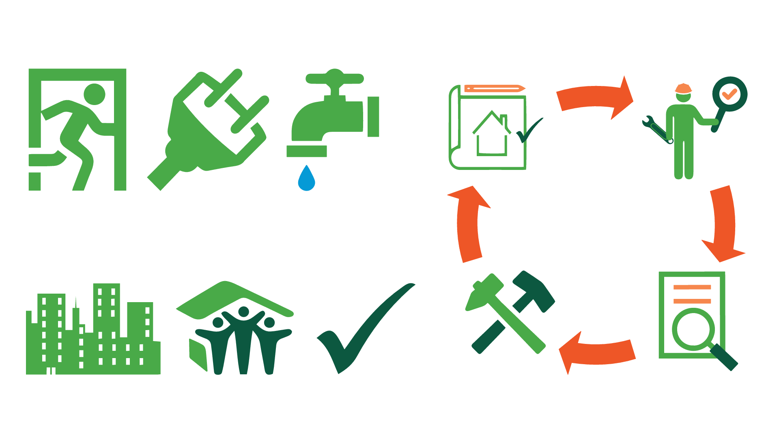
Who shapes the safety of the world around us?
Notes:
Who shapes the safety of the world around us?
Think about the building we’re all in right now. It has a foundation, likely built of wood, steel or concrete.
Now look around. Do you see a clear pathway to exit the room in the event of an evacuation? What about a fire sprinkler? Electrical outlets or plumbing pipes?
Did you know that each of these construction elements, from electrical, plumbing and mechanical pieces, to fire protection and energy efficiency, have a set of corresponding building codes that outline fundamental safety standards?
These building codes are essential pieces to the building and construction process – outlining necessary standards related to structural stability, fire and weather hazard protection, electrical wiring safety, evacuation pathways, and more.

Slide 4

Who shapes the safety of the world around us?
Notes:
Code officials are responsible for ensuring the safety and compliance of these codes and standards. They inspect building plans and construction processes to guarantee every building constructed follows these sets of codes and standards designed to ensure safety for the community.
It is code officials that shape the safety of the world around us, and serve as the safety foundation for our buildings.

Slide 5

Code officials stand behind the security and stability of every building where you live, work and play.
Notes:
But code officials don’t just ensure the safety for this building – rather, a code official is behind the security and stability of every building where you live, work and play.
In fact, they touch every building that you come in contact with – from small grade apartment buildings to high-rise commercial buildings to football stadiums.

Slide 6

Code officials also help our communities weather unforeseen disasters.
Notes:
But beyond ensuring that buildings are constructed to withstand the stress of everyday use, code officials also help our communities weather unforeseen disasters like storms and fire.
It is their safety checks that protect your home from emergencies before fire, flood or disaster strike. They ensure firewalls are sealed properly to protect structures in the event of a fire hazard, and check beams and stability features to ensure buildings stand after an earthquake.
What’s more, when code officials do their jobs to ensure building safety, first responders to these emergencies have less to worry about and can do their jobs more safely. The inspections and reviews code officials conduct are preventative measures, so when a hurricane or tornado hits, or a wildfire spreads through a town, structures constructed in accordance with building codes are more likely to withstand disaster – saving you and the community at large the cost, time and pain of rebuilding.

Slide 7
Code officials bring building codes to life across the building and construction cycle.
Building Plan and Permit Approval
Site Inspection
Renovations
and Rebuilding
Code Interpretation Support and Consultation
Notes:
Code officials are an essential piece in the building and construction puzzle, and are engaged in the building process from the initial building plan to the finished product.
For an example of how code officials bring building codes to life, when you or a family member is considering a home renovation, you would first hire a contractor or architect to help develop plans for the structural changes of your dreams – whether a new porch, spacious master bathroom or revitalized kitchen. From there, before ground on the renovation project is even broken, a permit is needed to ensure that the plans you envisioned on paper are in-line with building codes that will ensure they meet the minimum requirements to be deemed safe and sturdy. A code official inspects the drawings and specifications for the planned renovation to provide the safety stamp of approval, and then serves as a resource for you and the contractors, architects or engineers on the project team throughout the building and construction process. Their safety checks and ongoing site inspections ensure a stairway’s guard rails are sufficiently constructed to prevent falls, that electric outlets have secure wiring and will not short circuit your home, or that window frames are placed in the right location with appropriate materials to avoid shattered glass.

Slide 8

And thanks to code officials, our buildings stand, our communities prosper and our homes are safe.
Notes:
END “BASIC” PRESENTATION; PROCEED TO CLOSING SLIDE (18)
Code officials are an important part of every community. They form the foundation to building safe, sustainable and resilient buildings, and contribute to the economic wellbeing and development of a community.
So even though you may never see a code official in action, you can trust they are all committed to your safety.
Thanks to their dedication, care and concern our buildings stand, our communities prosper and our homes are safe.

Slide 9





ATTRIBUTES
Essential
Dedicated
Qualified
Professional
Who are Code Officials?
Notes:
But who are code officials, and what does it take for them to be successful in ensuring building safety?
Code officials are essential, qualified and dedicated professionals working in your community. They take safety seriously, and above all are here to help.

Slide 10





COMPETENCIES
Relationship Building / Customer Service
Curiosity
Community-Oriented
Communications
Ability to Multi-Task
Attention to Detail
Who are Code Officials?
Notes:
To be successful, code officials should be strong communicators and capable of building relationships and addressing customer service needs with the public, first responders and stakeholders throughout the built environment. They provide guidance and advice to architects, engineers and contractors to help them bring building plans to life, while also ensuring these buildings create a safe and sturdy environment for those who use them.
Code officials should also be able to multi-task between the wide variety of projects they may be working on, and have strong attention to detail to inspect the code compliance of each building site or plan.
Beyond these skills and abilities, code officials are community-oriented, dedicated to making the world around them a safer place.

Slide 11

Their knowledge spans every aspect of the life of a building – from the bottom of the foundation to the top of the roof – and everything in between.
Energy Conservation
Mechanical
Plumbing
Green Construction
Fire
Swimming Pool and Spa
Fuel Gas
Property Maintenance
Residential
Zoning
Notes:
Their knowledge spans every aspect of the life of a building – from the bottom of the foundation to the top of the roof – and everything in between. Code officials have opportunities to serve as a building safety generalist, but also to become experts in the ins and outs of specific code specialty areas. For example [presenter to choose examples based on personal experiences and audience]:
Plan reviewers are the first stop in the building evaluation process. They examine the construction documents used to describe a project, which include architectural, structural and construction elements like mechanical and plumbing drawings and calculations. These reviewers spot code compliance issues before construction even begins to ensure safety – and also save the builder time and money.
Building inspectors review drawings and specifications for planned repairs of existing buildings, construction of new building projects and building sites being considered for development.
Public works inspectors support government projects such as airports, highways, water and sewer systems, streets, bridges and dams, and are typically well versed in reinforced concrete, dredging or ditches.
Electrical inspectors check the quality of materials, the installation work and the safeguards in electrical systems. They make sure electrical systems meet city, state or national codes, and electrical codes and standards. Electrical inspectors look closely at new wiring and fixtures in businesses, public buildings and in homes.
Mechanical inspectors focus on heating, ventilating and air-conditioning (HVAC) concerns. The mechanical inspector also checks for air quality and energy conservation measures.
Plumbing inspectors check for proper design and installation of plumbing systems, including sanitary and storm drainage systems, sanitary facilities, water supplies, and storm water and sewage disposal in buildings.
Beyond knowing the intricacies of buildings, specifically, code officials also enjoy visibility to a wide array of different community projects and sectors of the built environment, from traditional construction projects to emerging and innovative disciplines in technology and energy efficiency. Project opportunities span private businesses, residential applications and public works initiatives across a regional jurisdiction.
Inspectors also have a dynamic workday – working both indoors and outdoors between office settings and construction sites. In an office, code officials read blueprints, review building plans, review correspondence, write reports or schedule inspections. The rest of their time is spent in hard hats inspecting construction zones, or on the road between different projects and job sites. Becoming a code official is a chance to make a difference, while also working in an active environment rather than being tied to a desk.

Slide 12

They impact every building in
every community.
Public Protection
Code Compliance
Economic Development
Notes:
Code officials truly impact every building, in every community.
When code officials apply their knowledge, skills and abilities to their work, you can see the impact! They:
Protect the public through their commitment to building safety.
Enforce code compliance to empower and educate stakeholders across the built environment to embrace and integrate safety standards in their work.
Support economic development by making our buildings studier, and therefore longer lasting and more likely to withstand whatever life may throw our way.

Slide 13

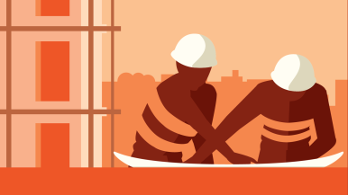



The personal and professional
perks of the job …
Diversify your skillset and access continuous learning
Make a difference in your community
Learn about the built environment
Achieve work- life balance
Enjoy salary, benefits and job security
Architects
Contractors
Engineers
Government Officials
Students
… attract code officials from a variety of educational backgrounds and experiences.
Notes:
Code officials come from a variety of backgrounds. Many have experience as architects, engineers, contractors or even government officials. What’s more, becoming a code official is a profession you can pursue with a bachelor’s or associate’s degree, or right out of high school with the right training and certifications.
Becoming a building code official is also a pathway for those interested in pursuing a government or regulatory-focused career, as code departments play a significant role in community planning decision making as an intersection between government, business and built environment stakeholders.
Beyond the community impact we discussed earlier, the code official profession provides individuals access to continuous learning and varied work, while also allowing you to diversify your skillset and maintain a stable and consistent work-life balance.
Specifically, many code officials point to salary, benefits and job security as primary reasons they pursued a career as a code professional. The median salary for code officials, per a 2014 ICC demographic survey was between $50,000 and $75,000 per year, ranging up to nearly $100,000 annually for some. Compared to the median household income of around $56,000 reported by the U.S. Census Bureau for 2015, code officials earn a stable and often above average living.

Slide 14
Their work is important, dynamic and rewarding.
“We ensure that the built environment is safe, sound, resilient and comfortable.”
“When we do our jobs right, first responders have less to do and can do their job more safely.”
“We protect human life by ensuring buildings are safe to occupy.”
85%
Would recommend the career field to others
Notes:
Code officials find their work to be important, dynamic and rewarding.
A survey conducted by the Minnesota Building Officials in 2015 found that 85% of the current code officials surveyed would recommend the career field to others.
In a survey conducted by McKinley Advisors in spring 2017, code officials also lent insight into the impact of their work, as outlined in these quotes focusing on the value code officials deliver to their communities.
Whether you are looking to begin your career, or have experience in related fields or trades like architecture, engineering or construction, becoming a code official could be your gateway to performing important and dynamic work that truly makes a difference for your friends, family and neighbors.

Slide 15





Your community needs more code officials.
80%
Over the next 15 years, the building industry will experience a loss of 80% of the existing skilled workforce.
Notes:
The code official workforce is looking for more code officials to meet their community’s safety demand. The current workforce is beginning to retire, meaning the code official job market is anticipated to grow and the profession is ripe for the next generation of code officials to develop their skills and make a difference. All we need is you to spread the word and learn more about the profession!

Slide 16
Visit local high school or junior colleges!
Spread the word about Code Council Membership Councils!
Invite someone to an ICC Chapter meeting!
Tell someone about ICC Committees!
Follow ICC on social media to stay updated!
So help spread the word about the profession!
Notes:
ICC, the International Code Council, supports the growth and development of code officials and is the premier source for the building codes and standards that code officials need for their work.
ICC has membership councils, committees, chapters and resources for current code officials to develop professionally. Plus, ICC members spread the word about the profession in presentations like this to encourage the next generation of code officials to learn more about the value and benefits of the role.

Slide 17
Safety 2.0 Programs
Emerging Leaders Membership Council (ELMC)
High School Technical Training Program (HSTTP)
Members in the Military
Chapter Leadership Academy
Board Shadow Program
Journey to Leadership
Code Council Innovation
And get involved in ICC’s Safety 2.0 programs to build the next generation of code officials.
Notes:
ICC has also launched the Safety 2.0 initiative – a suite of programs, services and resources that are specifically geared towards students, young professionals and those interested in joining the code official profession.
ICC recognizes the importance of continuing to grow awareness of the work code officials do and the impact they have, in the hopes of encouraging new ICC members and aspiring code officials to join in on the building safety movement.

Slide 18
CODE OFFICIALS Building Safety Today for a Stronger Tomorrow
Learn more about how code officials protect your community at www.iccsafe.org.
Notes:
Code officials ensure building safety today, for a stronger tomorrow.
If you, or someone you know, enjoys creative problem solving, is curious about the built environment and has an interest in making a difference in your community –becoming a building code official may be the career path for you! Learn more about the code officials in your community, and how you too can support building safety and economic development at www.iccsafe.org.

Slide 19
APPENDIX:
ADDITIONAL IMAGES AND SLIDES, TO USE BASED ON PRESENTER NEEDS/ PREFERENCES

Slide 20
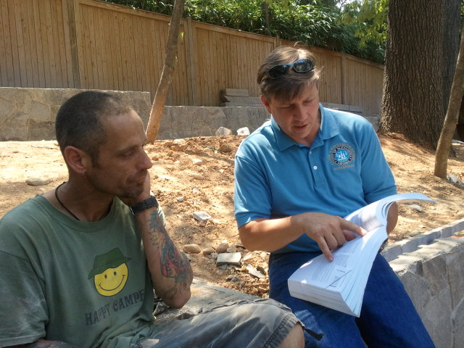
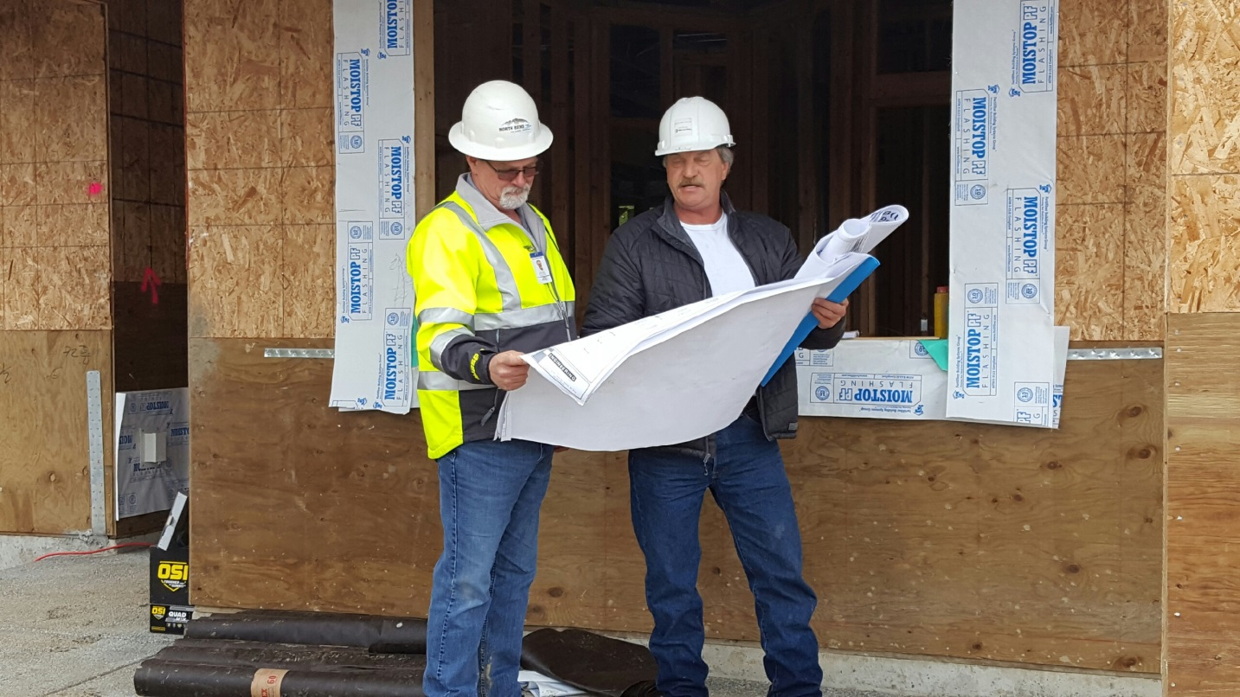
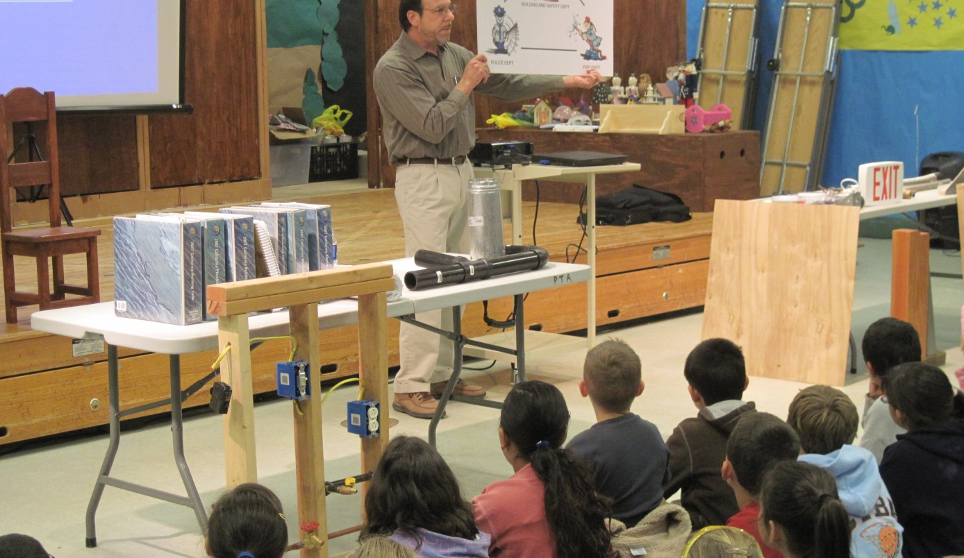
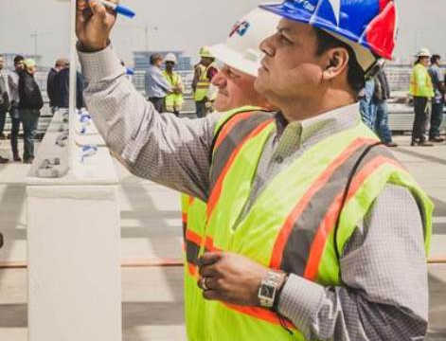
Code Officials in Action

Slide 21
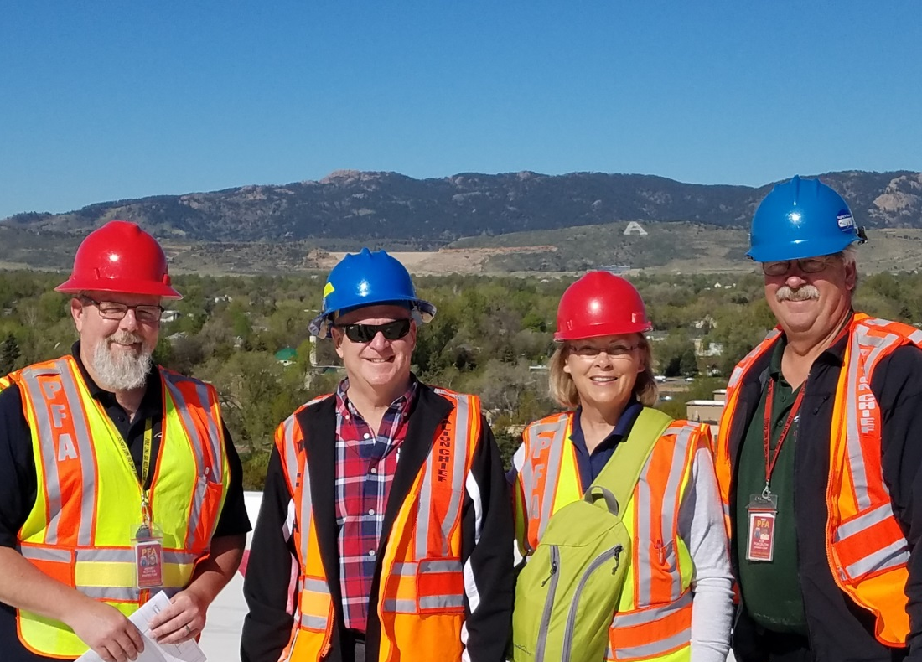
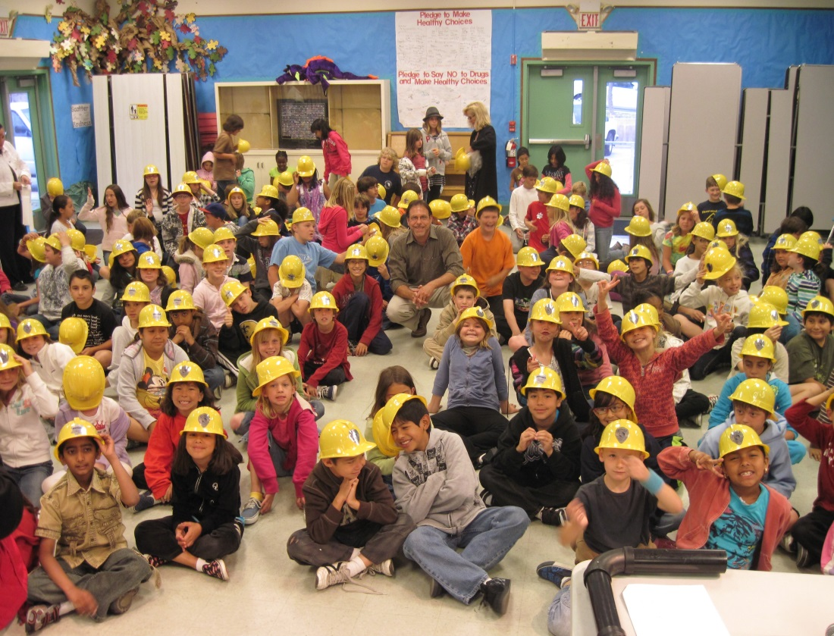
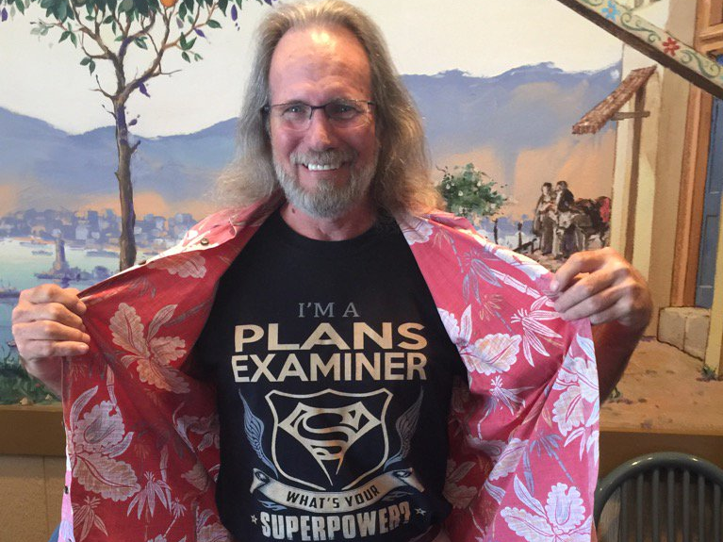
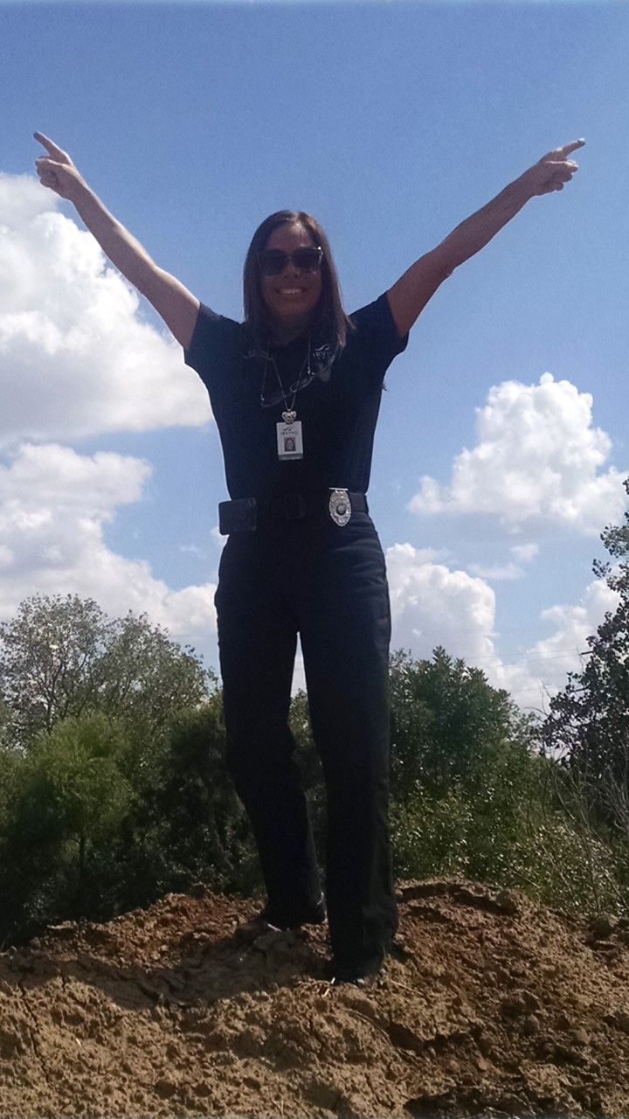

Slide 22
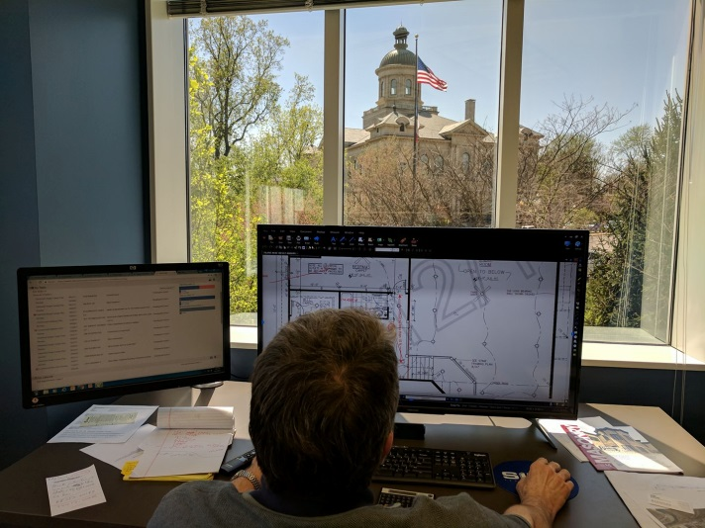
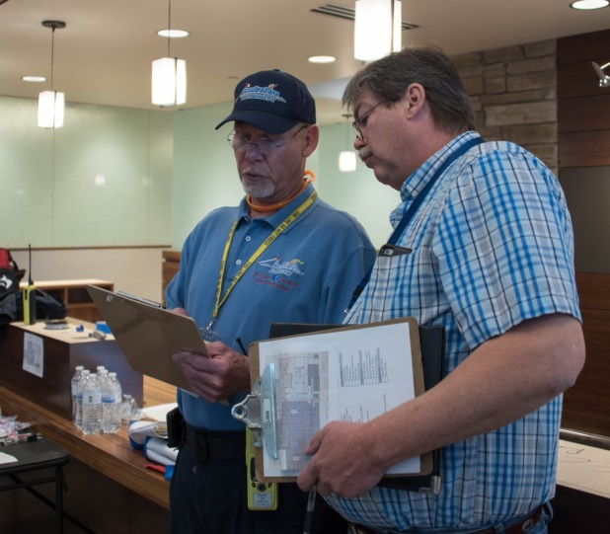
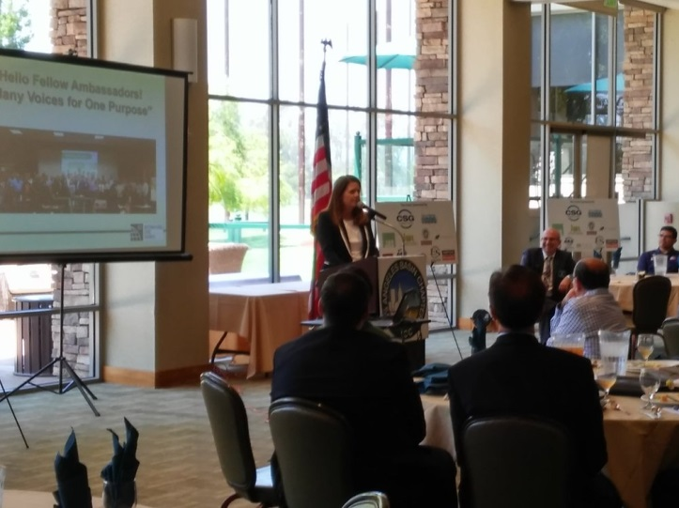
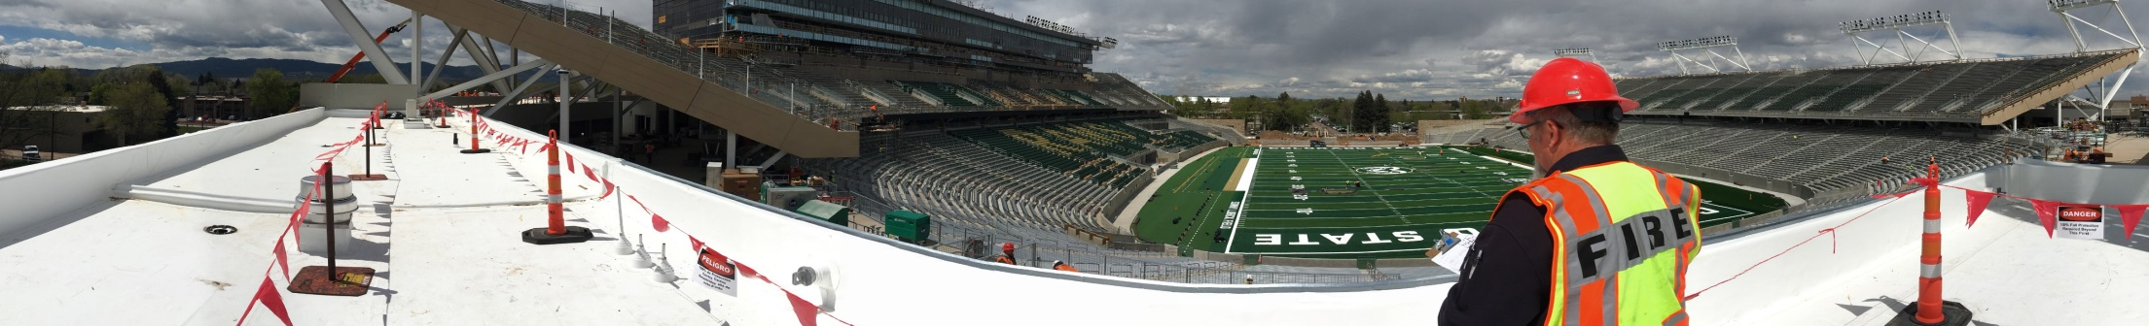
Day in the Life of a Code Official
Plan Review and Permit Approval
Community Meetings and Presentations
Code
Consultation
Site Inspection

Slide 23
“Extremely rewarding, always helping people, always learning, never a dull moment, always in demand. If you stop and think about the inspection you just performed, the plans you just
reviewed or the complaint you just settled, you can consider yourself a pre-first responder.”
“This is an exciting, steady and rewarding career. For those that are either interested in the trades or being a professional engineer, building inspection and building department administration can be far more rewarding, as you maintain vigilance over all structures built in your jurisdiction to ensure they meet the minimum standards of the laws and codes.”
The Value of Becoming a Code Official
Quote Source: 2014 ICC Demographic Survey

Slide 24
“Research and understand the job responsibilities of a code enforcement professional.
Get a job that provides hands-on experience within one or two construction related fields, such as framing and concrete. Research and study the code books. Become familiar with procedures of constructing a building. Learn the nomenclature. Stay current on both current trends and the future direction of construction. Read, study and speak with people with long careers to gain
advice and perspective. Never stop learning.”
“Get all of the vocational training you can, and work in the building trades field, so you have a good understanding of how a structure should go together. Work for a good, reputable contractor for at
least two years and train, train, train.”
Recommendations for Success
Quote Source: 2014 ICC Demographic Survey

Slide 25

Code Officials are Code Heroes.

Slide 26
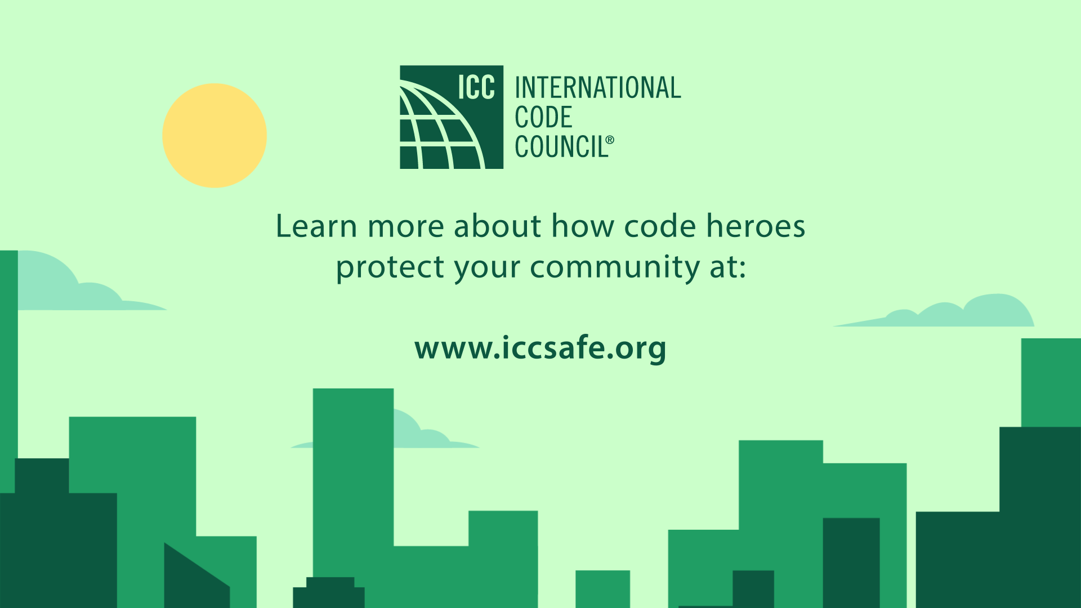
Code Officials:
Building Safety Today
for a Stronger Tomorrow
Copyright © 2017 International Code Council, Inc. All rights reserved.

