Slide 1
How to Build a Successful Leadership Team
2025 Chapter Leadership Academy
Rachel Parrish, PE, MCP, CBO
Development Services Engineer, City of San Antonio
April 26, 2025

Slide 2
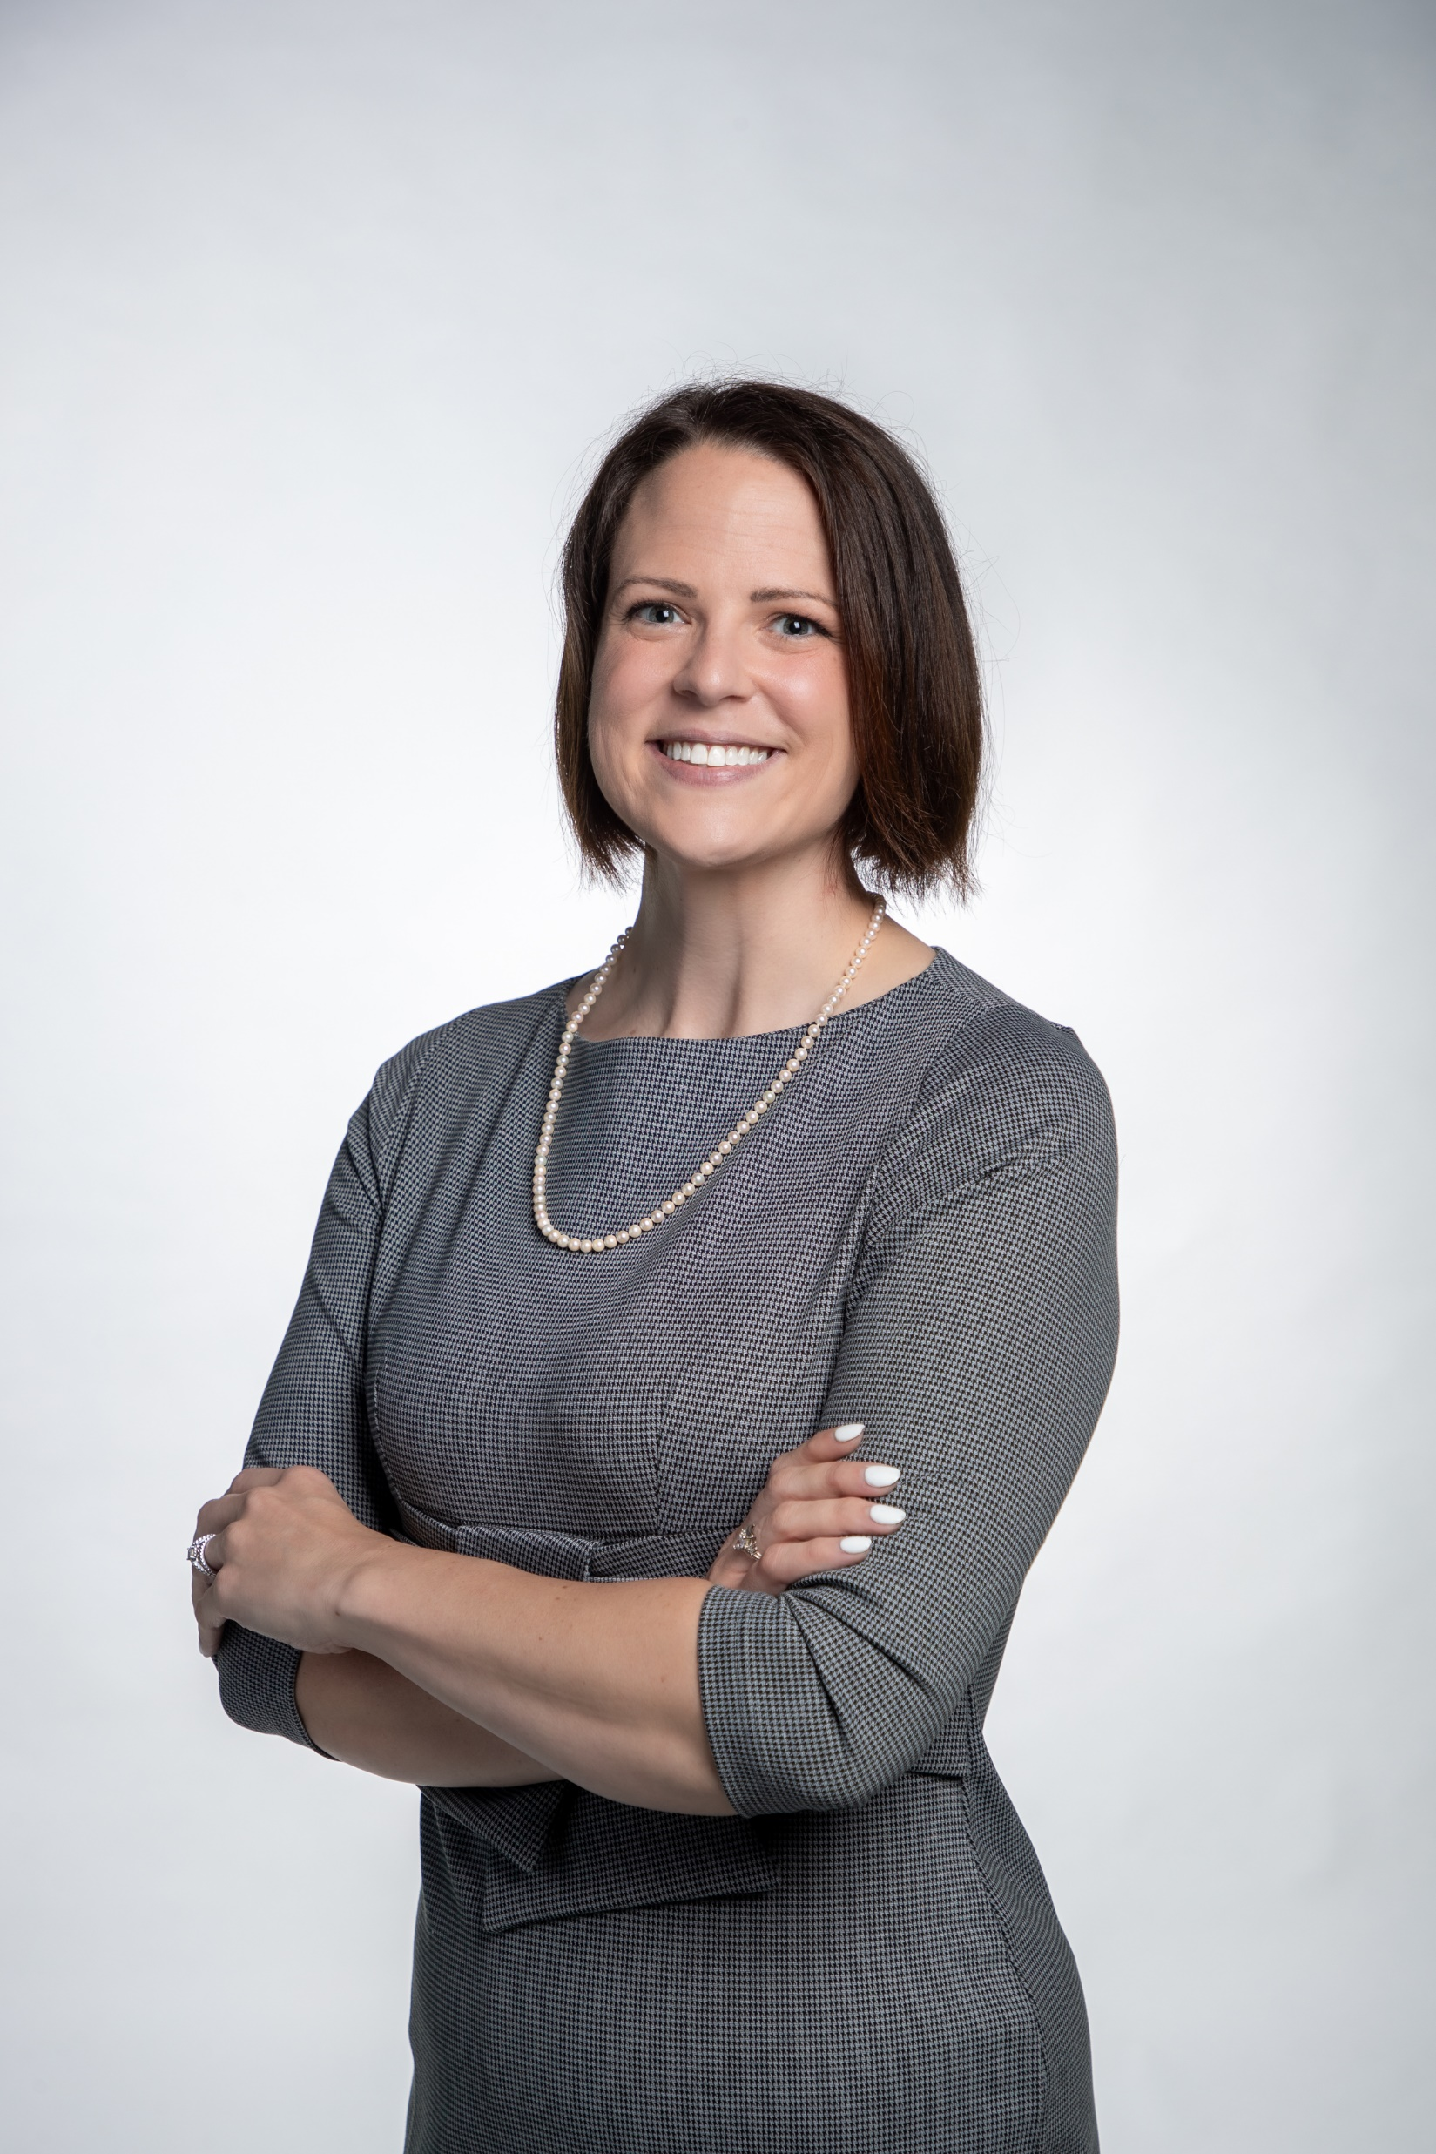
Introduction: Who am I listening to?
Civil Engineer – Texas A&M University
City of San Antonio – 7 years
  Drainage and Floodplains
  Streets and Traffic
  Trees and Landscape
  Plan Review
  Street Construction Inspections
  Building Inspections
Management – 7 years
  Team sizes: 5 – 80 employees

Slide 3
Objectives
What makes a good team
Learn what to look for when hiring
How to build trust and respect
The psychology of getting things done
Notes:
How do we know what we’re looking for?
How do we find it?
How to nurture it
How to control it

Slide 4
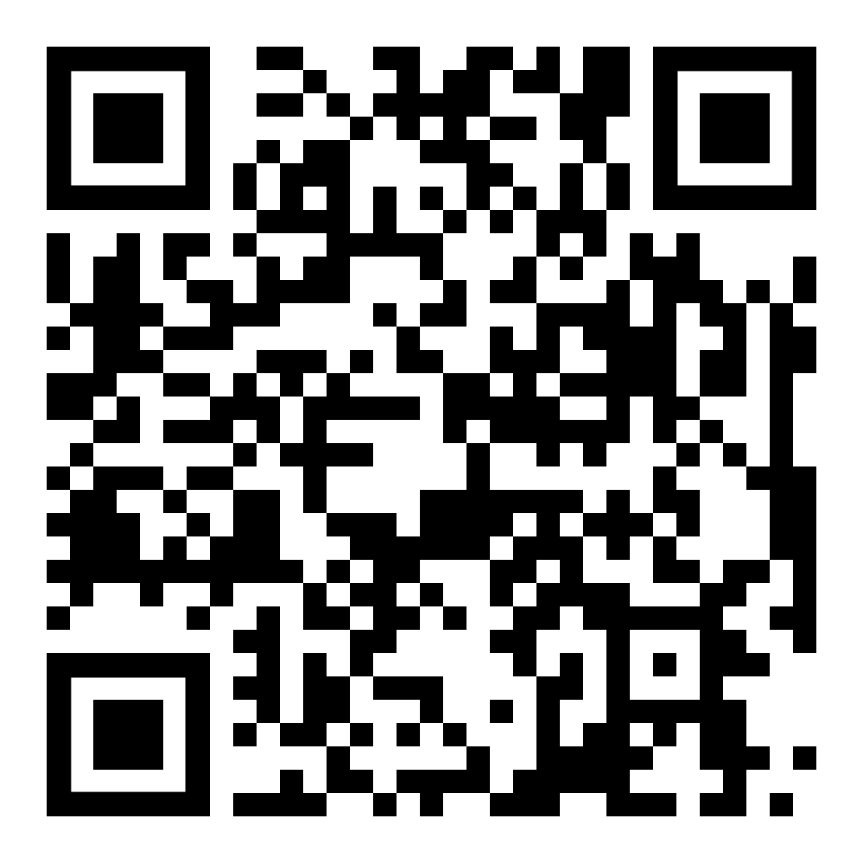
Myers-Briggs Personality Test
Notes:
Myers-Briggs Test for those who don’t know their personality type
Will have 4 letters
Won’t take time for this. Take it on your own time

Slide 5
Know Yourself
Carl Jung/Myers-Briggs – 4 Measurable Categories
Carl Jung/Myers-Briggs – 16 Personality Types
  Energy
  Mind
  Nature
  Tactics
Extravert (E) vs Introvert (I)
Sensing (S) vs Intuition (N)
Thinking (T) vs Feeling (F)
Judging (J) vs Perceiving (P)
Notes:
Carl Jung – Theory of Psychological Types
Later expanded upon by Katharine Briggs and her daughter Isabel Briggs Myers
Test is based on 5 personality aspects
Energy – How we interact with our surroundings
Introverts – Prefer solitary activities, are exhausted by social interaction, and are sensitive to sensory stimulation
Extroverts – Prefer group activities, are energized by social interaction, and are easily excited
Mind – How we see the world and process information
Observant/Sensing – Highly practical, have strong habits, and are focused on the past or present.
Intuitive – Imaginative, curious, and focused the future.
Nature – How we make decisions and cope with emotions.
Thinking – Focus on logic over emotions, efficiency over cooperation, and hide their feelings
Feeling – Express emotions and are empathetic. Less competitive and focus on cooperation.
Tactics – Our approach to work, planning, and decision making.
Judging – Decisive, organized, value predictability and structure.
Perceiving (or Prospecting) – Good at improvising, flexible, and nonconformists.

Slide 6
 | IN | IS | EN | ES
TJ | INTJ – Architect | ISTJ - Logistician | ENTJ - Commander | ESTJ - Executive
TP | INTP - Logician | ISTP - Virtuoso | ENTP - Debater | ESTP - Entrepreneur
FJ | INFJ – Advocate | ISFJ - Defender | ENFJ - Protagonist | ESFJ - Consul
FP | INFP - Mediator | ISFP - Adventurer | ENFP - Campaigner | ESFP - Entertainer
Orange – Explorers
Blue – Sentinels
Green – Diplomats
Purple - Analysts
Extravert (E) vs Introvert (I)
Sensing (S) vs Intuition (N)
Thinking (T) vs Feeling (F)
Judging (J) vs Perceiving (P)
Notes:
Purple – Analysts – Rational and impartial, independent and strategic, but can have difficulty in social settings.
Architect – Strategic thinkers with a plan for everything.
Logician – Innovative with a thirst for knowledge.
Commander – Strong willed leaders that will find a way.
Debater – Smart thinkers that like intellectual challenges.
Green – Diplomats – Empathetic and cooperative, warm and influential, but can have difficulty making rational, difficult decisions.
Advocates – Quiet and inspiring idealists.
Mediator – Kind and altruistic. Always helping people.
Protagonist – Charismatic and inspiring leaders.
Campaigner – Creative, positive, and sociable.
Blue – Sentinels – Creates order and meticulous, do well with rules and difficult tasks, but can have a hard time accepting different points of view.
Logistician – Practical and reliable. Focuses on facts.
Defender – Dedicated, protectors, and defend loved ones.
Executive – Excellent administrators and managers.
Consul – Caring, social, and popular.
Orange – Explorers – Spontaneous and practical, uses many tools and good in a crises, but can undertake risky endeavors.
Virtuoso – Practical experimenters. Masters of various tools.
Adventurer – Flexible and charming artists who like new things.
Entrepreneur – Smart, energetic, like living on the edge.
Entertainer – Spontaneous, energetic, and enthusiastic.

Slide 7
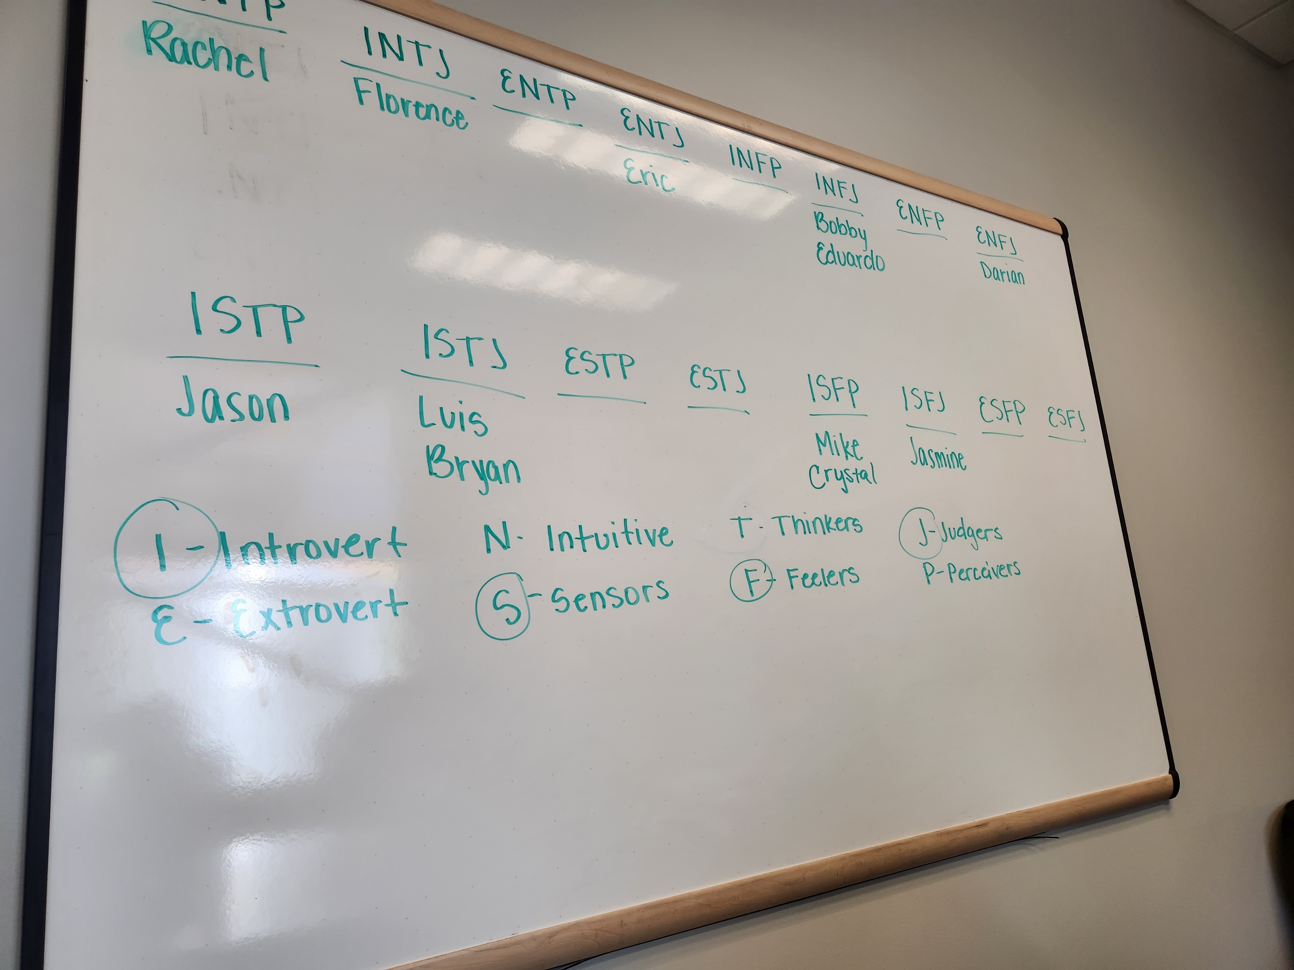
Know Your Team
Same vs Mixed
Example Team
Diversity
Notes:
Would you expect a team of similar personalities or vastly different personalities to work the best?
Teams with the same personalities can get along better, but there’s a limit to the overall capabilities
Embrace vastly different personalities.
Teambuilding must be a priority for different personalities to understand each other.
Each personality has a unique strength that can contribute to the overall effectiveness of the team.
Example Team:
There’s a wide variety of personalities.
Teambuilding is important to get these personalities to mesh.
Leads to better decisions if there’s trust.
Examples:
Florence is very solutions driven. If someone needs an empathetic listener, she would direct them to me.
Florence has a handle on team morale and would let me know if it dropped.
Eric is reliable and will do what you need him to do, but it can be difficult to get him to focus.
Mike is personable and people will talk to him, but he has a hard time accomplishing tasks.
Jasmine is easy to talk to and technical but can focus on negative things and be difficult to work with.
We talked about what we are good at and what our weaknesses are. Bluntly and openly.
My personality:
My team knows I’m highly organized to the point that it’s difficult for me to work if things are unorganized.
It’s difficult to control my emotions when I’m stressed and people get directed to another source for an answer or come back later.

Slide 8

Hiring Well and Firing Infrequently
What traits do you need?
How important is experience?
Should we consider culture?
Notes:
When picking your team: Interviews are important
Pick the traits that this person needs to do this job: organization, networking, soft skills, self-motivated
Gear the questions to look for these traits:
How would you go about organizing this project?
Give an example of a time where you have needed cooperation from another department you did not have authority over.
Give an example of when there was a conflict you needed to mediate and what was the result?
Give an example of a project you weren’t asked to do, but did anyway. How did you find this project. What did you do?
Look for subtle signs
If it sounds like a canned answer, ask for another example. People generally only prepare one answer.
Pull answers out of nervous interviewees.
Look for red flags.
Tendency to blame others for issues. Doesn’t take responsibility.
When leading teams, they stepped in to do the work.
“Lead by example”
How important is experience to you?
Culture is huge in employee retention. Look for people who may not be able to handle the company culture.

Slide 9
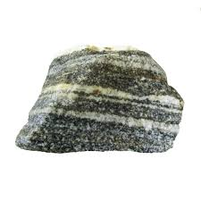
Types of Power – Hard Power
Legitimate
Reward
Coercive
Notes:
How do you manage this team?
Hard Power – A method of exerting power through force
Legitimate Power – The formal authority a leader has due to their position in an organization.
The higher the position, the more power.
Reward Power – The possibility of monetary or non-monetary compensation.
Control over raises.
Coercive Power – The ability of the leader to penalize employees to follow orders.
This includes threats.

Slide 10

Types of Power – Soft Power
Expert
Referent
Personal
Notes:
Soft Power – The ability to influence people through persuasion and attraction.
Expert Power – Perception that the leader has superior knowledge.
Doesn’t need to be in the related field.
Referent Power – Perception that the leader and the follower have a personal identification or connection.
Personal Power – The leader’s personal qualities like trust and courage that cause others to follow.

Slide 11
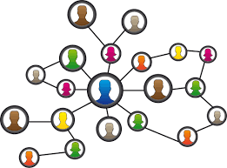
Types of Power - Other
Connection
Information
Notes:
Other types of power
Connection (or Network) Power – Indirect power through connections and networking.
It’s not what you know, it’s who you know.
Information Power – Power due to the control of information

Slide 12

Team Building
Respect
Trust
Leadership
Set ground rules
Everyone participates
No judgement
Confidentiality
Notes:
Team building is extremely important. Helps generate respect and trust for each other.
Set aside designated time to do this with structured tasks.
Examples include personality tests and discussions, discussions of future plans for the team, fun session with games.
Extra effect is teaching others how to become team builders.
Team building sessions must have certain elements
Ground rules that everyone agrees on.
Criticism is different than insulting
Team building is not optional
No one takes offense to other’s opinions
Be respectful when others are talking
Everyone participates
No judgement on people’s answers
Maintain confidentiality
Tips
Go around in a circle for answers and start in different positions
If someone isn’t participating, directly ask for their opinion
Generate an agenda and keep people on track
Keep it fun
Be willing to make fun of yourself
Open up to everyone so they will open up to you
Bring food
Keep it to an hour/hour and a half and have them more frequently
Pick a place with no distractions
Put a no technology rule in place. Don’t answer phones or emails.
Come with questions to prevent lulls in the conversation
Use somewhere with a whiteboard

Slide 13
The Psychology of the Meeting Table
Participant
Participant
Participant
Listener
Leader
Listener
Participant
Participant
Participant
Notes:
How do you know I’m the presenter before I start talking? How did I give myself the authority?
Who is the highest ranked person in the room?
Typical Meeting Table
Where does the meeting leader sit? Intuitively at the head of the table.
“Right hand man” next to the leader. But left is listened to more.
Seniority closer to leader
Listeners, but non-participants not at table.
How do you set the tone for your meeting?
If you need control – head of table, facing the door
If you need to be on equal footing and get ideas from others – Middle of table
If you are in a meeting but you need someone else to control – Listener position
To build trust – Sit next to, not across from
Sit on right side
Let the other person have their back against a wall, not the door.

Slide 14
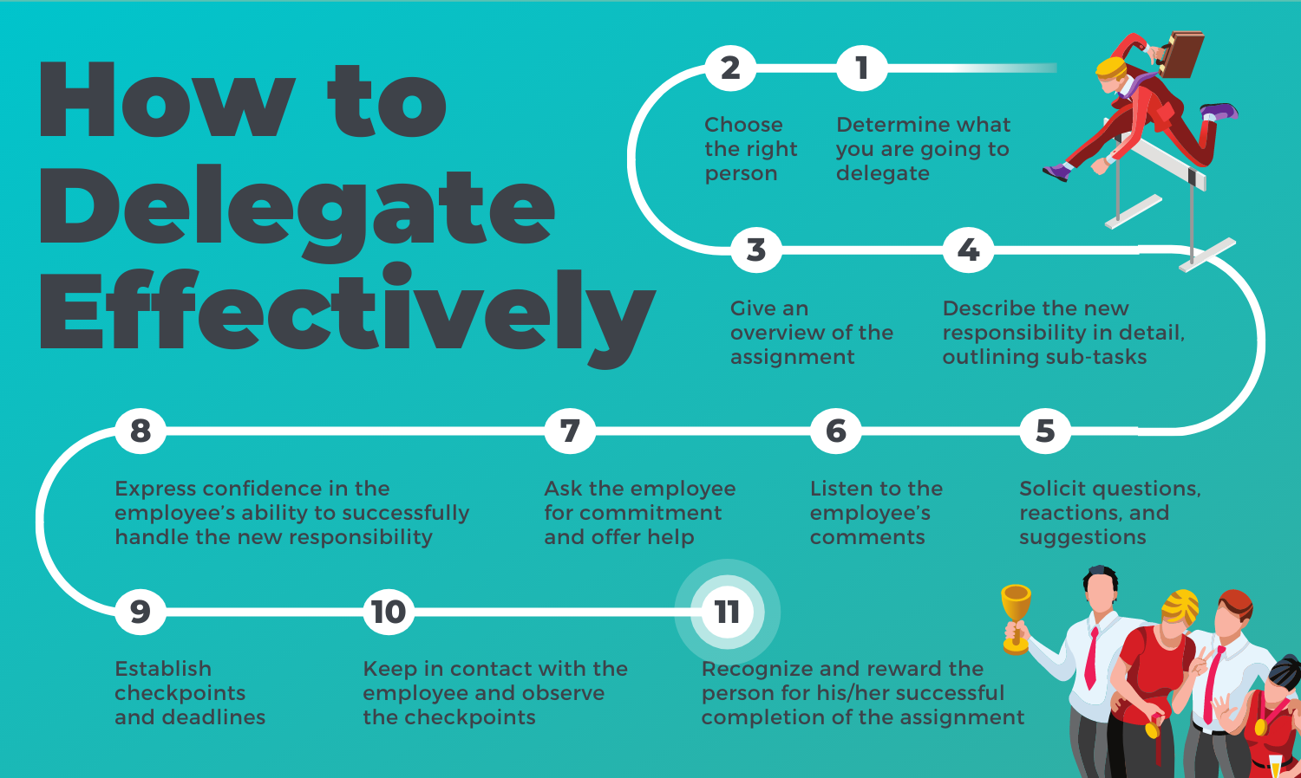
Delegation
When?
Who?
How?
Why?
When?
Who?
How?
Why?
Notes:
Being an effective leader means knowing how to use your resources to get a large amount of work done.
Delegation is one of the hardest things new leaders have to learn to do.
Feel like pawning off work
Feel like they need to show people they know how to do it
Feel like they’re the best person to do it
When to delegate?
Is there someone else who CAN do it?
Is there someone else who can professionally develop by doing it?
Can the business pay someone less to do it?
Is someone better at it than you?
Who?
Someone who can learn from it
Someone who can do it efficiently
The lowest paid person who can reasonably be expected to do it
How?
Ask! Don’t demand.
Explain why you’re giving them the task.
Explain exactly what you want and what the final product should look like.
Ask for questions.
Give a deadline and check-in dates.
Why?
More efficient
Creates learning opportunities
People see you recognize their expertise
Shows trust
Frees your time for more important items

Slide 15
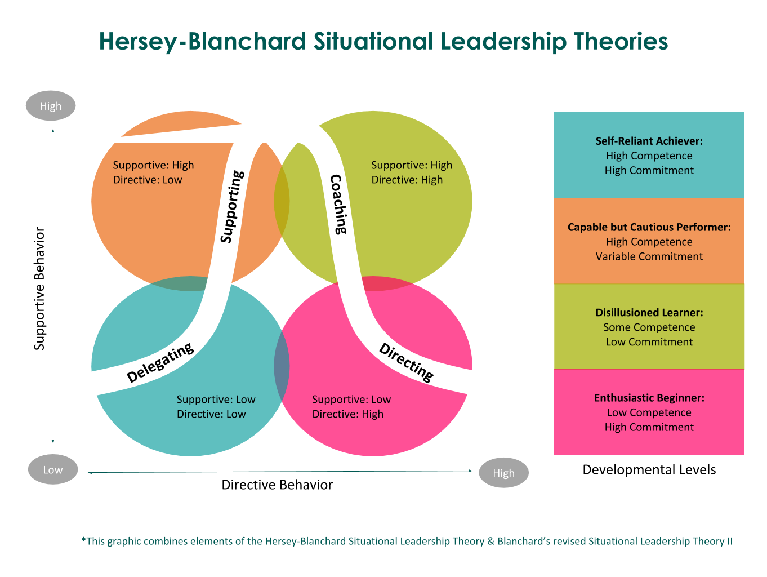
Notes:
You have a new hire that you need to train to do a job: Enthusiastic Beginner needs Directing
Generally dictating what the employee needs to do
Not a lot of free rein or creativity because the employee doesn’t know how to do the job yet.
Energetic and willing to learn and be a productive member of the organization.
You have an employee that has been there a couple of years, but is just cruising: Disillusioned Learner needs Coaching
They know how to do the job, but they aren’t committed to the cause.
Won’t be doing extra work and leader will need to assign tasks.
Requires the most work to bring them back into the fold
You have an employee that has been there at least 5 years that knows the job inside and out: Capable but Cautious Performer needs Supporting
Leader doesn’t need to tell them what to do
Leader needs to support and motivate the employee because there will be morale swings
Most employees are in this category with varying degrees of commitment.
You have a rising star employee that does their job well and wants to grow: Self Reliant Achiever needs Delegating
They know what to do and how to do it.
They self-motivate and are engaged
Give them tasks to promote ownership and growth.

Slide 16
1 |  | Unpleasant | 1 | 2 | 3 | 4 | 5 | 6 | 7 | 8 |  | Pleasant
2 |  | Unfriendly | 1 | 2 | 3 | 4 | 5 | 6 | 7 | 8 |  | Friendly
3 |  | Rejecting | 1 | 2 | 3 | 4 | 5 | 6 | 7 | 8 |  | Accepting
4 |  | Tense | 1 | 2 | 3 | 4 | 5 | 6 | 7 | 8 |  | Relaxed
5 |  | Distant | 1 | 2 | 3 | 4 | 5 | 6 | 7 | 8 |  | Close
6 |  | Cold | 1 | 2 | 3 | 4 | 5 | 6 | 7 | 8 |  | Warm
7 |  | Hostile | 1 | 2 | 3 | 4 | 5 | 6 | 7 | 8 |  | Supportive
8 |  | Boring | 1 | 2 | 3 | 4 | 5 | 6 | 7 | 8 |  | Interesting
9 |  | Quarrelsome | 1 | 2 | 3 | 4 | 5 | 6 | 7 | 8 |  | Harmonious
10 |  | Gloomy | 1 | 2 | 3 | 4 | 5 | 6 | 7 | 8 |  | Cheerful
11 |  | Closed | 1 | 2 | 3 | 4 | 5 | 6 | 7 | 8 |  | Open
12 |  | Backstabbing | 1 | 2 | 3 | 4 | 5 | 6 | 7 | 8 |  | Loyal
13 |  | Untrustworthy | 1 | 2 | 3 | 4 | 5 | 6 | 7 | 8 |  | Trustworthy
14 |  | Inconsiderate | 1 | 2 | 3 | 4 | 5 | 6 | 7 | 8 |  | Considerate
15 |  | Nasty | 1 | 2 | 3 | 4 | 5 | 6 | 7 | 8 |  | Nice
16 |  | Disagreeable | 1 | 2 | 3 | 4 | 5 | 6 | 7 | 8 |  | Agreeable
17 |  | Insincere | 1 | 2 | 3 | 4 | 5 | 6 | 7 | 8 |  | Sincere
18 |  | Unkind | 1 | 2 | 3 | 4 | 5 | 6 | 7 | 8 |  | Kind
Notes:
Think about the coworker you had the hardest time accomplishing anything with (not necessarily the one you liked the least).

Slide 17
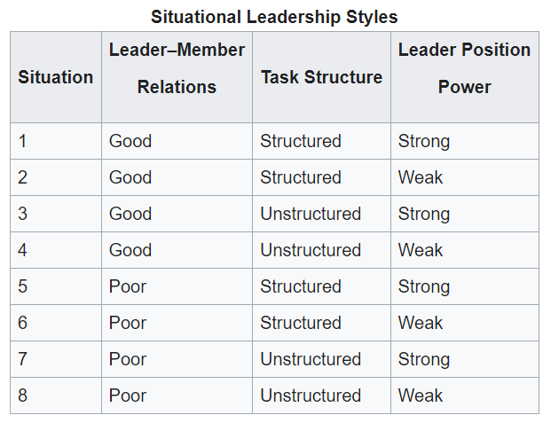
Notes:
Leader - Member Relations: The degree of mutual trust, respect, and confidence between the leader and the subordinates.
Task Structure – The extent to which group tasks are clear and structured. Structured is when members have a clear goal and know how to achieve it. Unstructured is when the goal is ambiguous with no clear solution or the members don’t know the approach to achieve the goal.
Leader Position Power – How much power does the leader’s position have in itself.
What situation are you currently in as a leader?

Slide 18
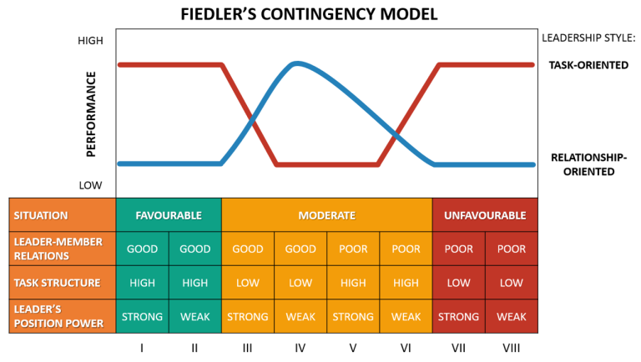
Notes:
Task Oriented Leaders do well in Favorable and Unfavorable conditions.
Relationship Oriented Leaders do well in mixed conditions.
What if you’re in a leadership role that doesn’t match leadership type and situation? This theory says, change the situation.

