Slide 1
Re-engaging Chapter and
ICC Members
Are your members getting the most from their ICC Membership?
Karla Price Higgs
Vice President, ICC Member Services
Notes:
For my session, I want to combine my two main jobs—Member Services and Chapter Relations—to talk a bit about Membership recruitment and retention.
After all, that’s what Chapter are: membership organizations. And many of us are struggling to recruit new members, to retain existing members, and to get all our members to understand the value of being an active participant in our organization. In other words… [next slide]

Slide 2
“Simply put, member engagement is the ongoing interaction between a member and organization in exchange for meaningful value.”
-Ashley Autry
blog.accessdevelopment.com
Notes:
…we need to re-engage our membership.
In the midst of a crisis, be it an economic crisis, health crisis, or other emergency, organizations tend to close in on themselves, to go into to survival mode. We only attend to required activities. This reaction is not bad—it’s a necessary part of crisis management. BUT survival mode is not a sustainable business model. At some point, we have to re-engage with each other. The organization must re-engage with its members, the members with their organization.
On this slide is a quote I found on the internet. Two phrases that stood out to me are “ongoing interaction” and “meaningful value.” As we look at the benefits of belonging to our organizations, we need to think about benefits that bring ongoing interaction with our members. What makes staying with your chapter important to your members? How do we reach out to our members in an ongoing way? And what has meaningful value for our members? These benefits don’t necessarily have to have a monetary value—just a meaningful one.

Slide 3
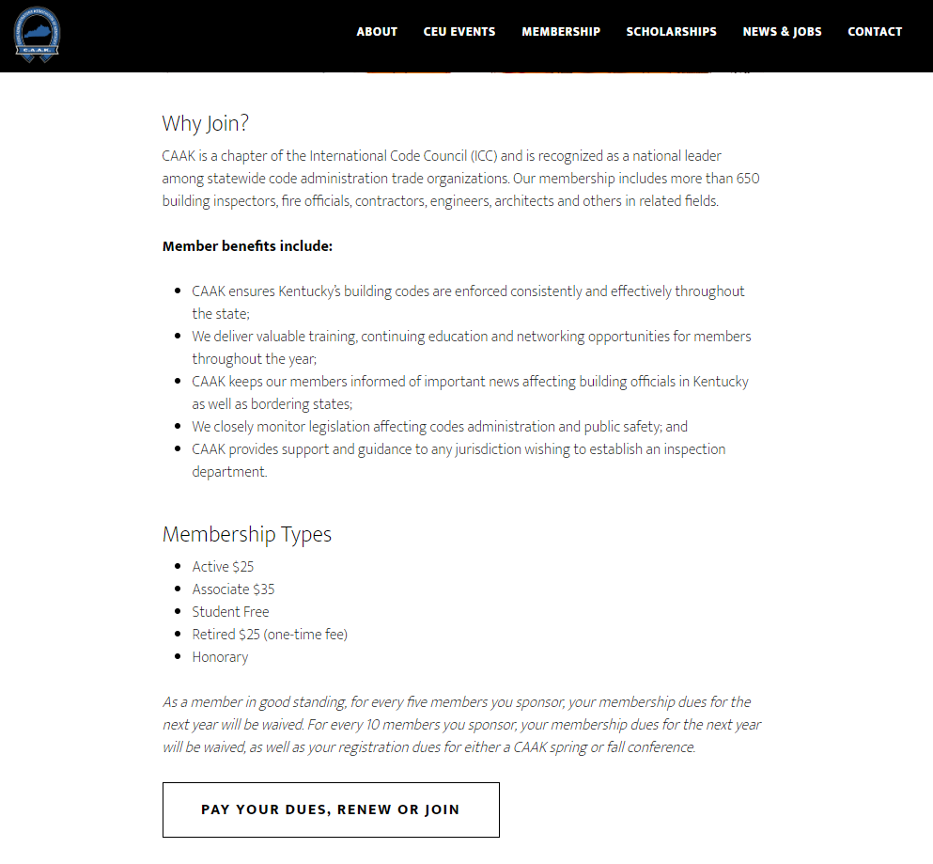
Notes:
Here’s an example a one of our Chapter’s benefits page from their website. This is from the Code Administrators Association of Kentucky (https://caak.org/membership/). Look at the list of benefits. These are benefits that stress an ongoing interaction with the State and with the membership. Phrases like “throughout the year” and “keeps our members informed” stresses this continuing relationship. The benefits are also worded in such a way that the value of the benefit to each member is clear.

Slide 4
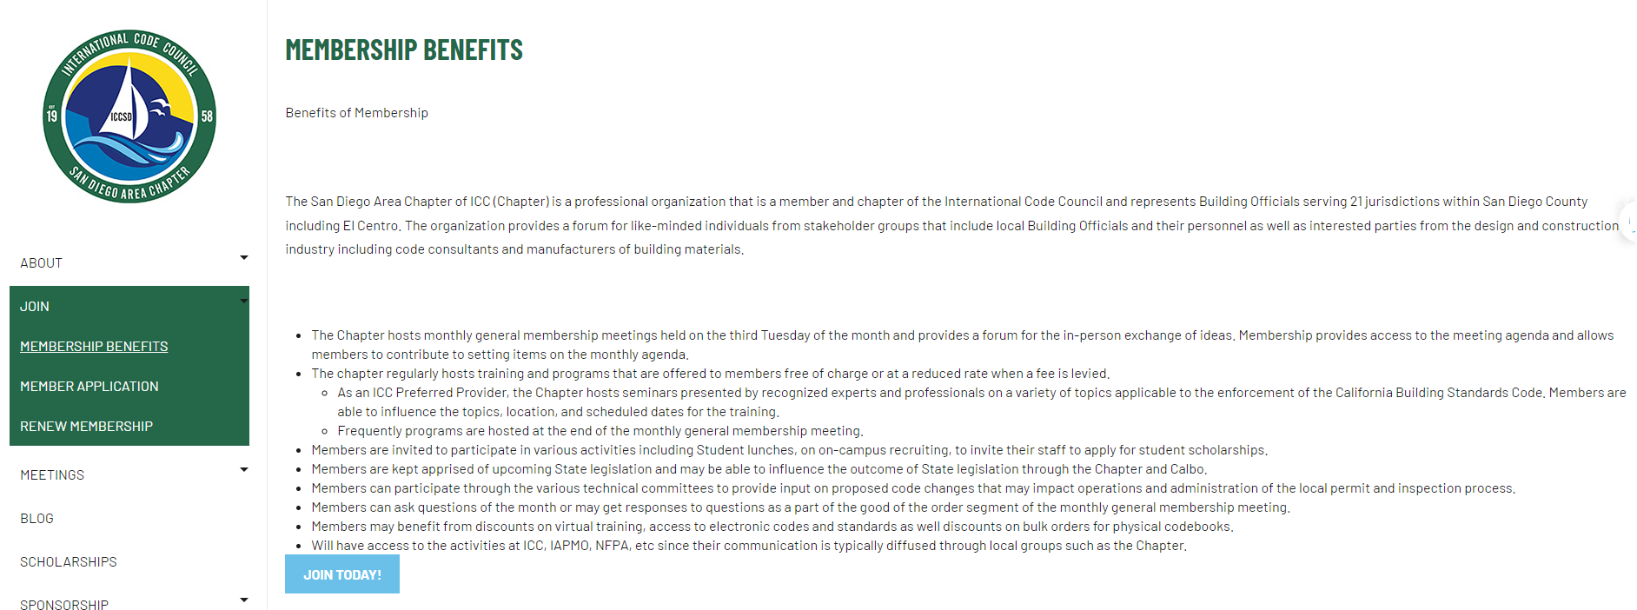
Notes:
The San Diego Area Chapter (https://iccsandiego.org/Membership_Benefits) is another great example of clear, valuable member benefits. The chapter emphasizes training opportunities, either free of charge or discounted for members. Many of the benefits begin with the word “Members” to gain the reader’s interest from the first. The first bullet items shows that member input is welcome and encouraged.
Note that many of these benefits are not costly to the chapter, but are clearly of meaningful value to the individual.

Slide 5
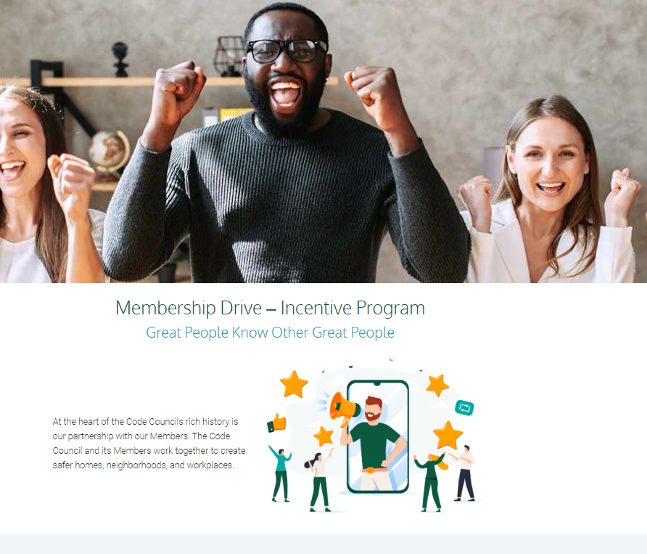
Notes:
One way the International Code Council is looking to re-engage with our own members is through a Membership Drive, due to launch in July. Members will be given a unique URL to share with colleagues who are not Members of the Code Council. For each person who uses that URL to join the ICC, the Member will receive $25 to redeem in the ICC store.
Many Chapter members are not ICC members. This drive is a great opportunity to reach out to these people and help them become more involved in your chapter and in the International Code Council.
Keep a lookout for more details!

